Slide 1

CEIS114 Course project
By Harrison Olvera
Prof. Abdulmagid Omar

Slide 2
Introduction
This project encompasses the utilization of the principles of technology, resources to build a smart traffic controller, and a portfolio appropriate for the digital job market.

Slide 3
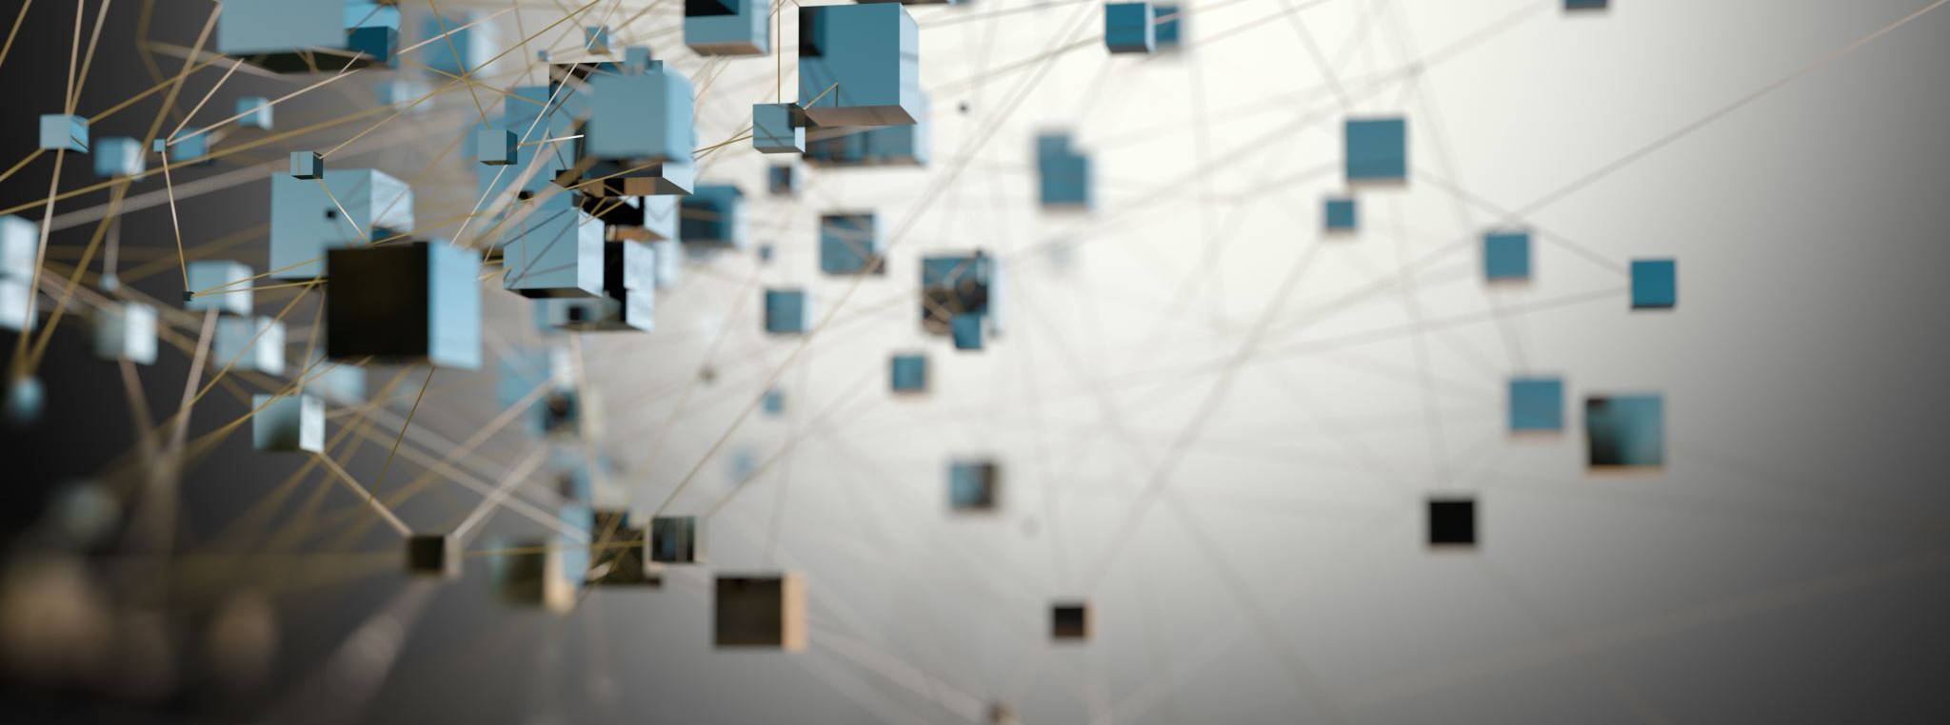
Project Plan for IoT Traffic Controller

Slide 4
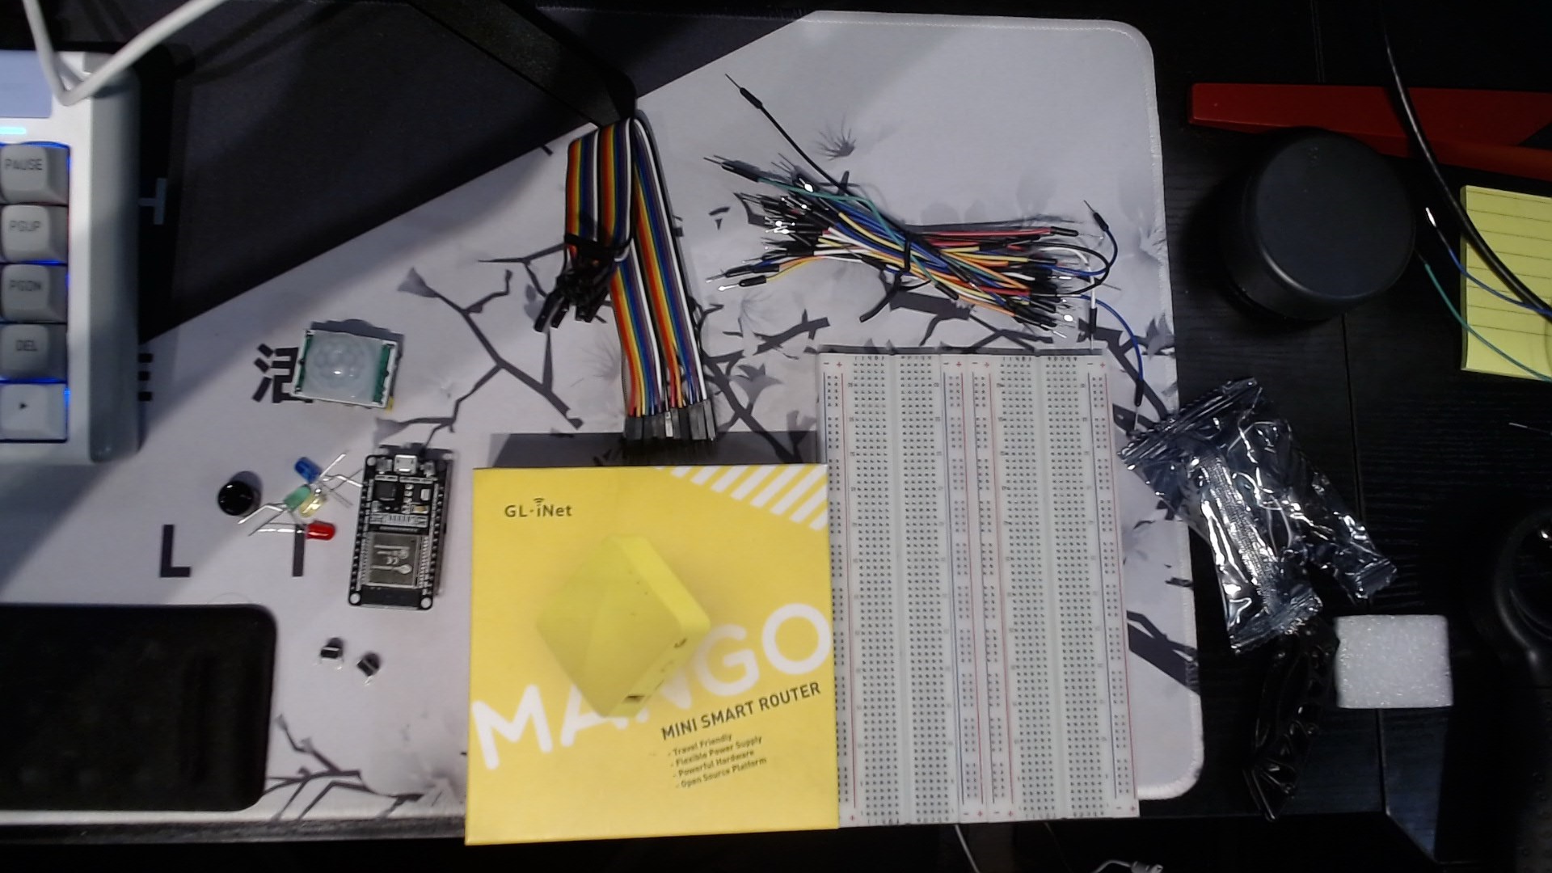
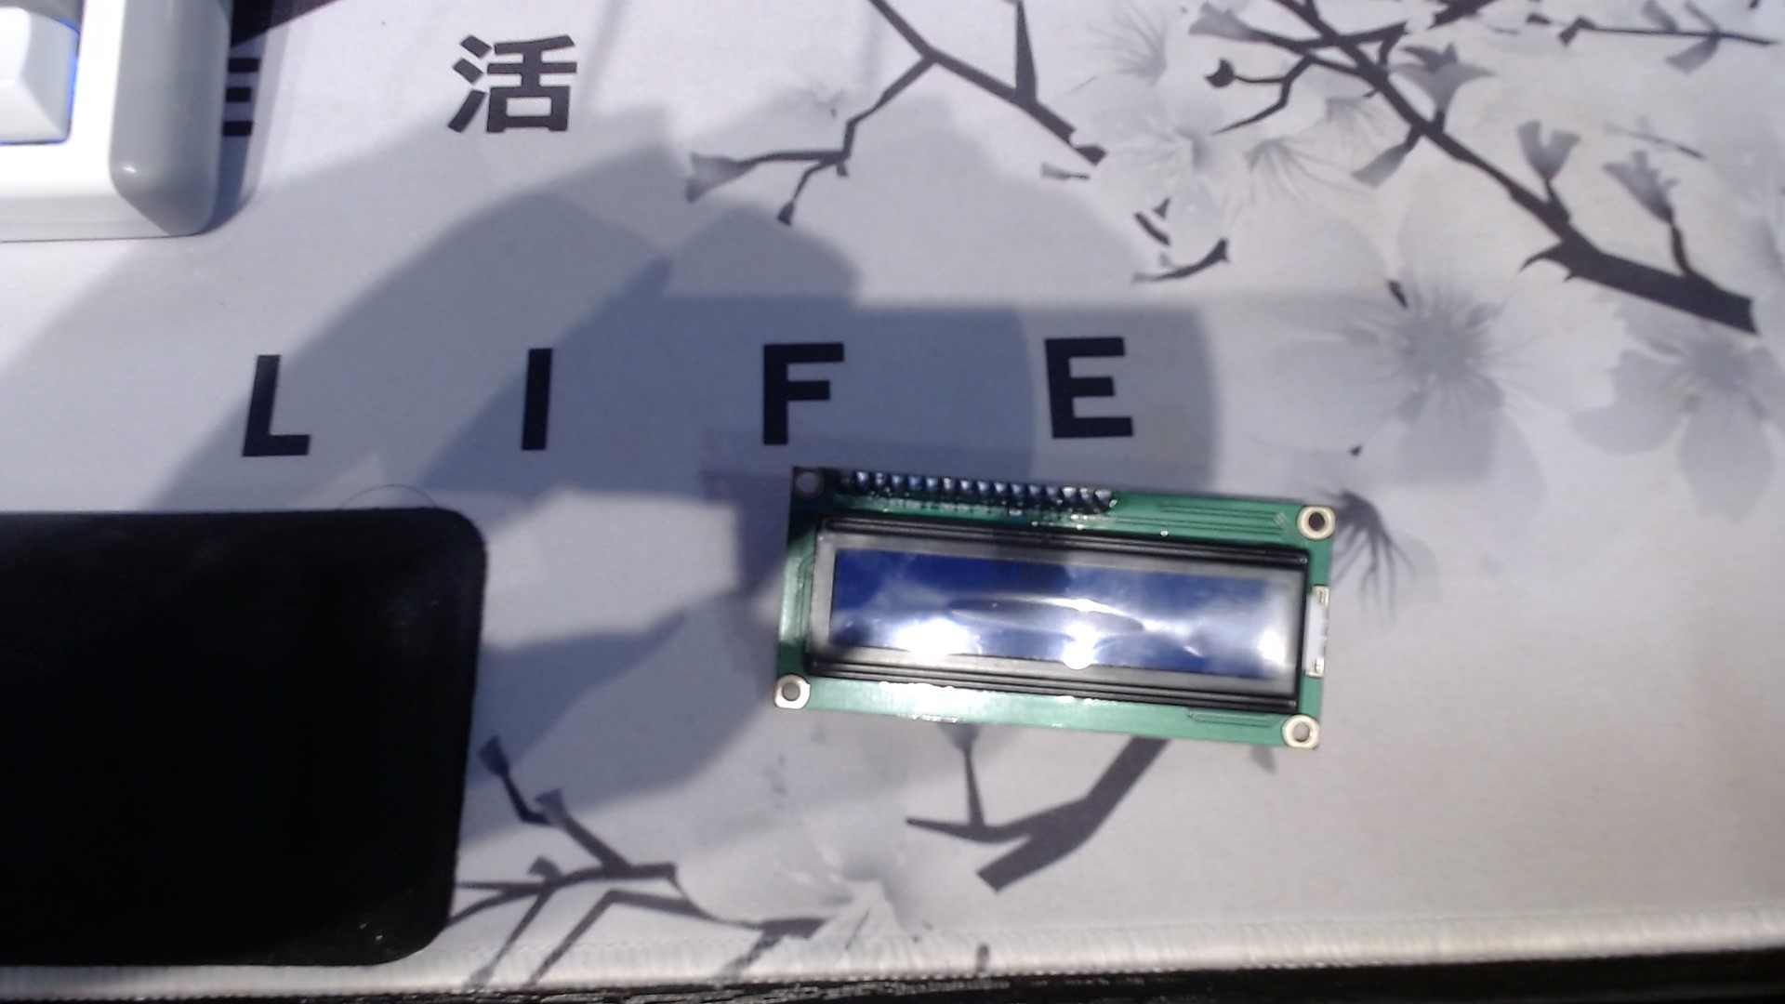
Inventory (picture)
ESP 32 Board
Colored LEDs: Red, Yellow, Green, and Blue
220 Ohm Resistors (optional)
Wires
Breadboard(s)
LCD Unit with I2C Adapter
Active Buzzer
Mini Router
Push Button(s)
PIR Motion Sensor

Slide 5
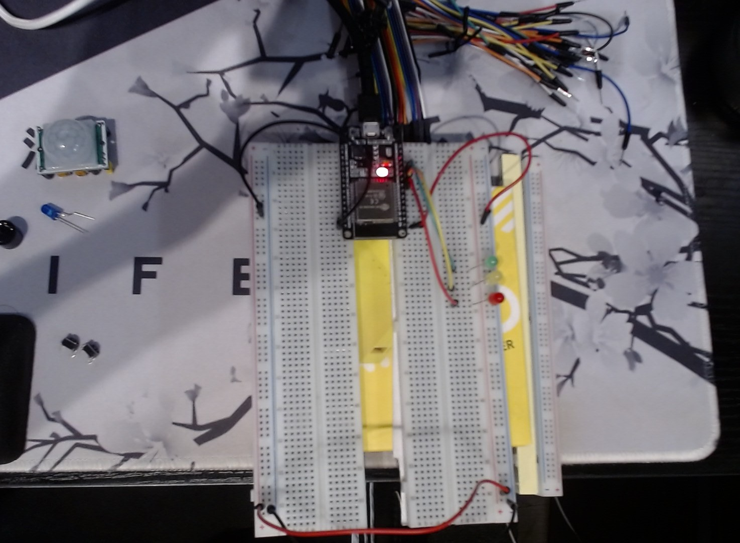
ESP32 (picture)
Microcontroller mounted and powered ON

Slide 6
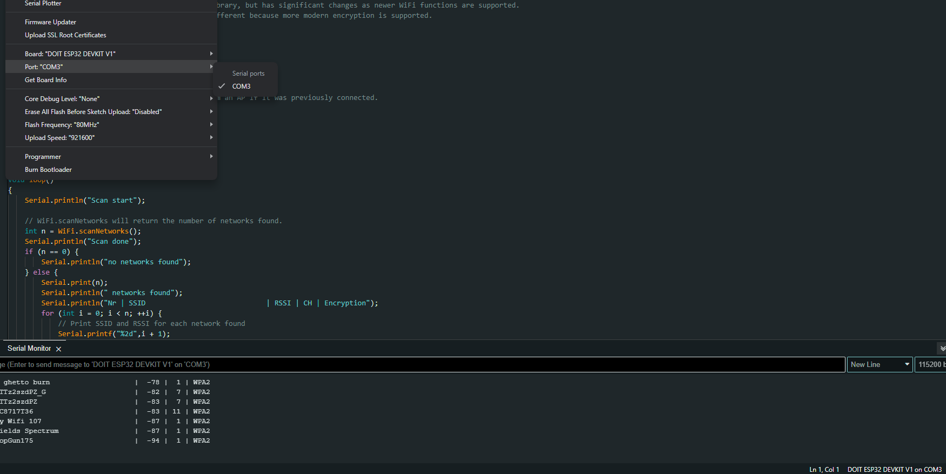
Installation of Arduino IDE
Screenshot of Arduino IDE with Port selected from Tools menu.

Slide 7
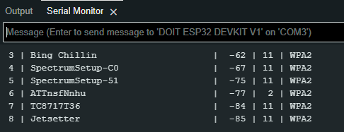
Esp32 wifi scan
Screenshot of Serial Monitor in Arduino IDE showing the available networks

Slide 8
Creating the Traffic Controller

Slide 9
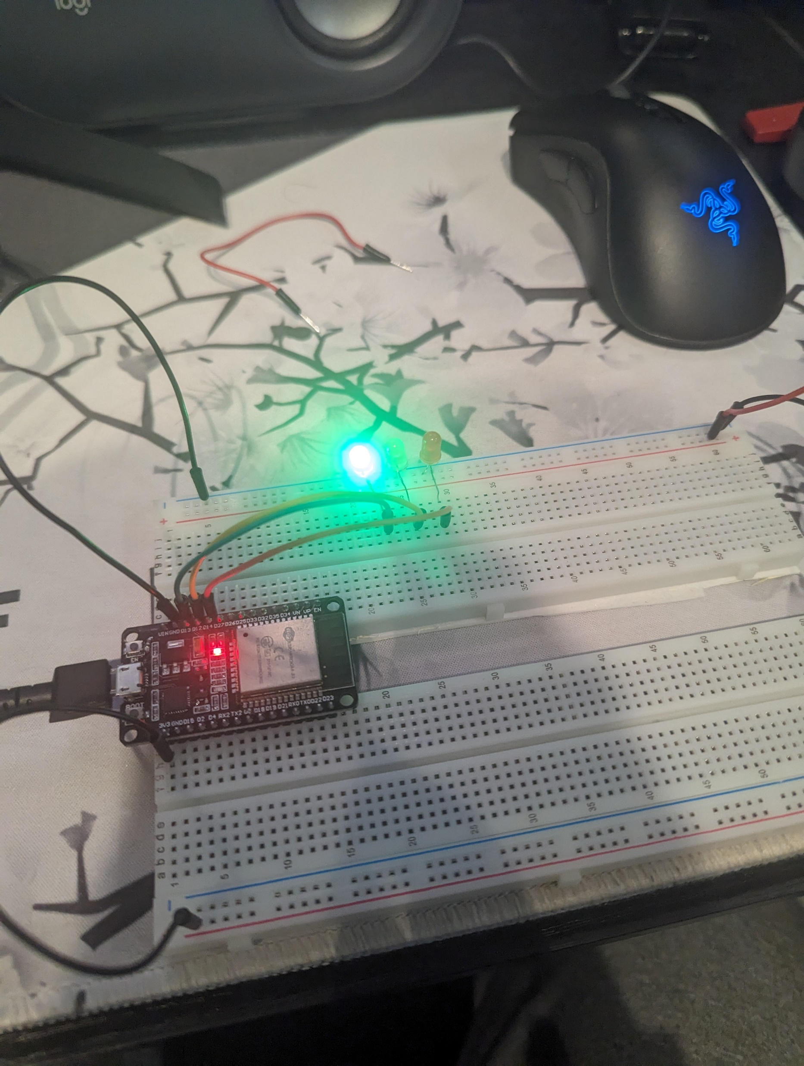
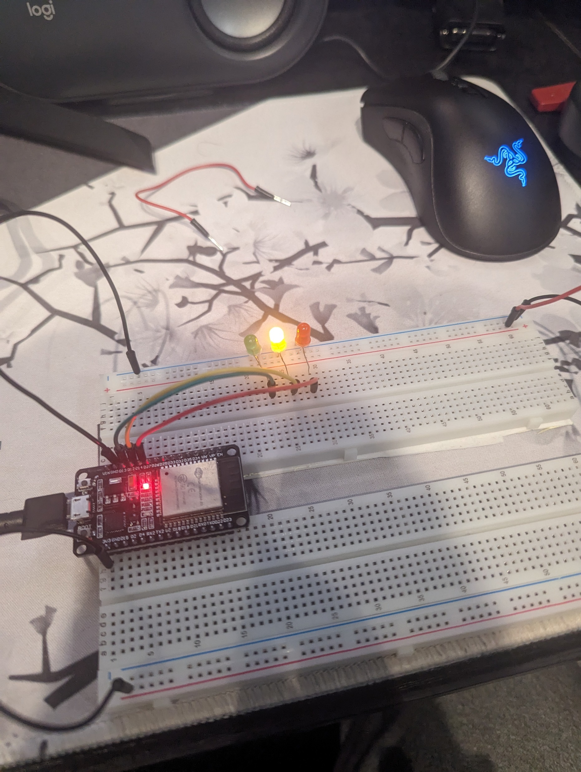
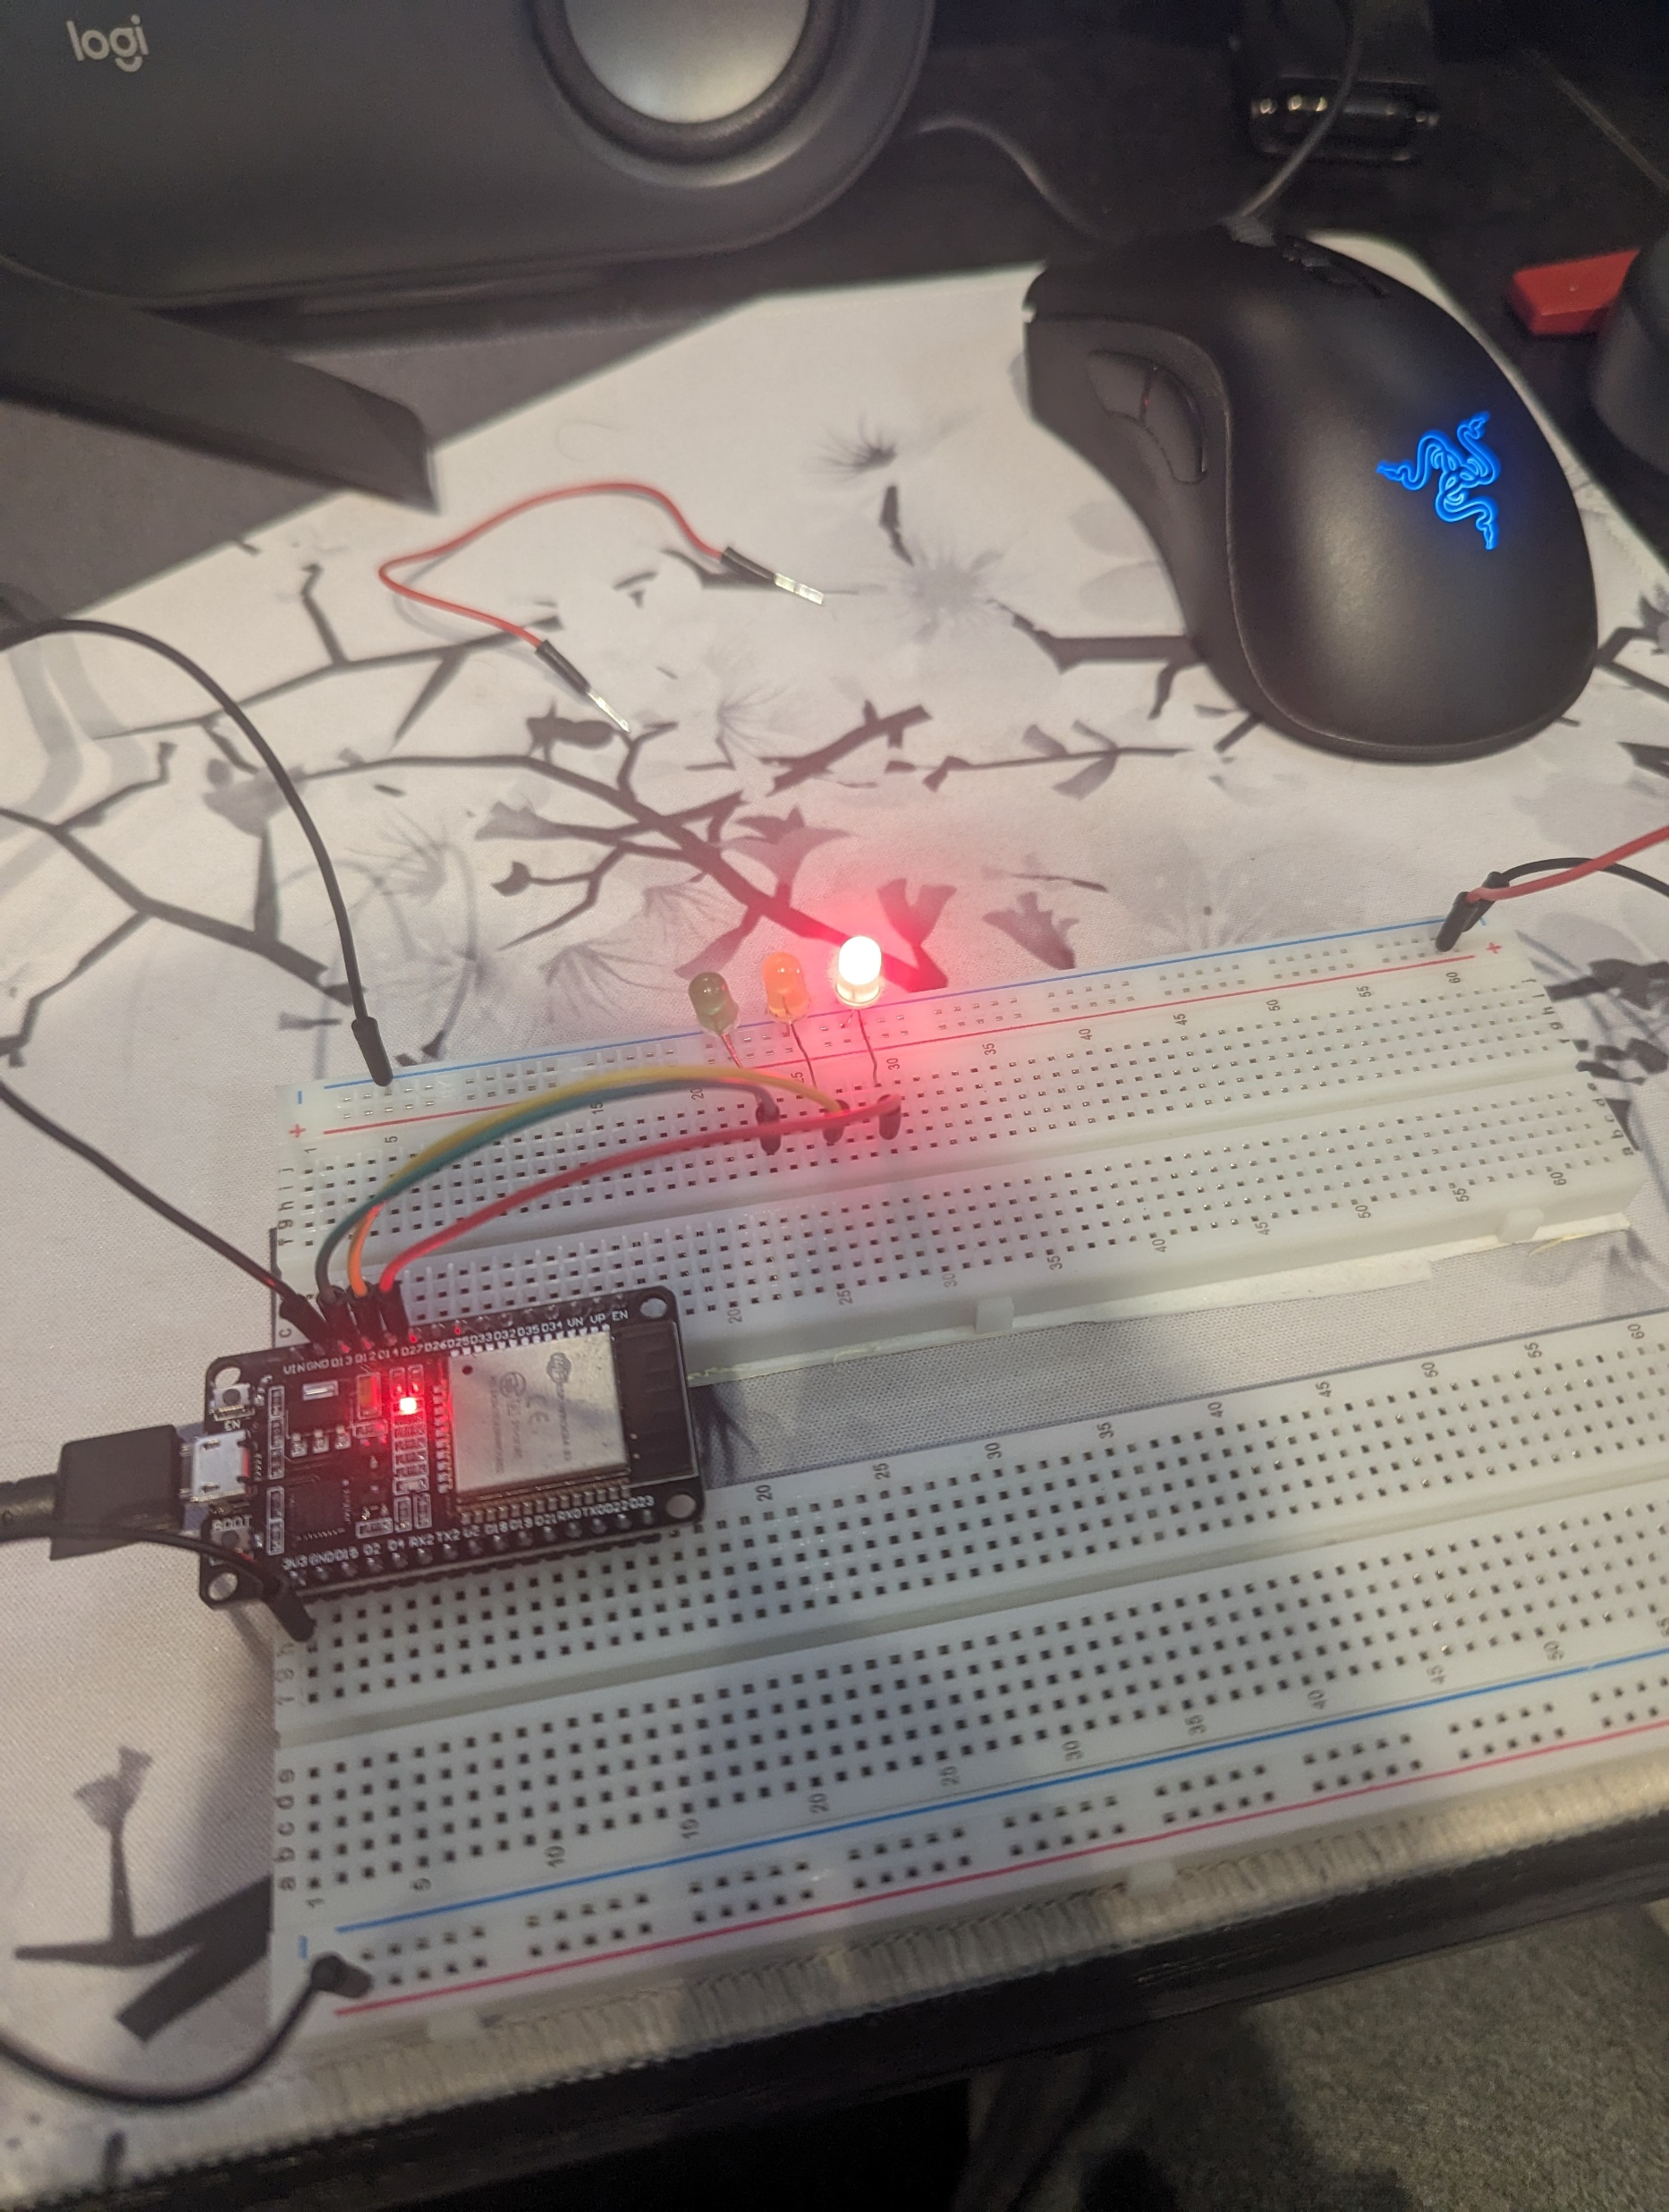
Picture of circuit with working LEDs
ESP 32 Board
Colored LEDs: Red, Yellow and Green
220 Ohm Resistors (optional)
Wires
Breadboard

Slide 10
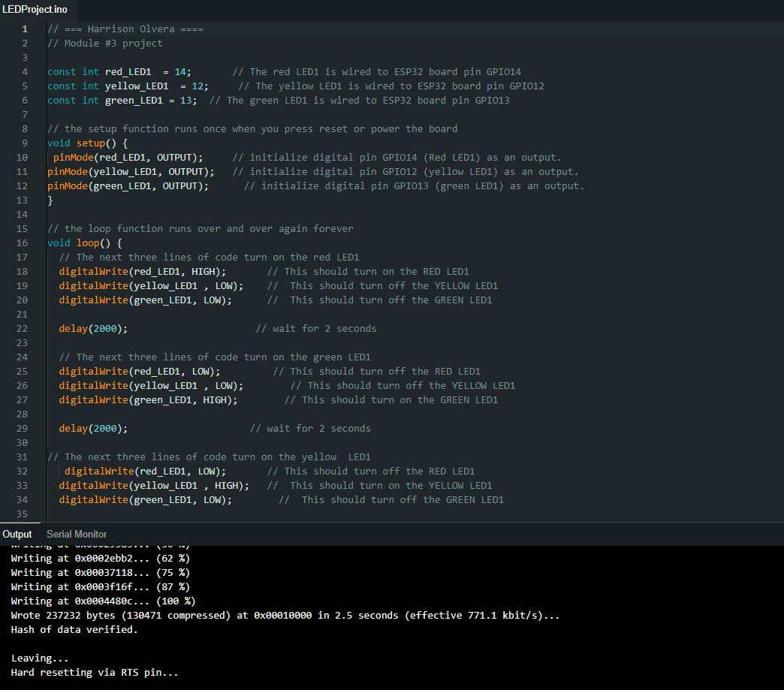
Screenshot of code in Arduino IDE
Screenshot of code in Arduino IDE showing your name in the comment

Slide 11
Creating a Multiple Traffic Light Controller

Slide 12
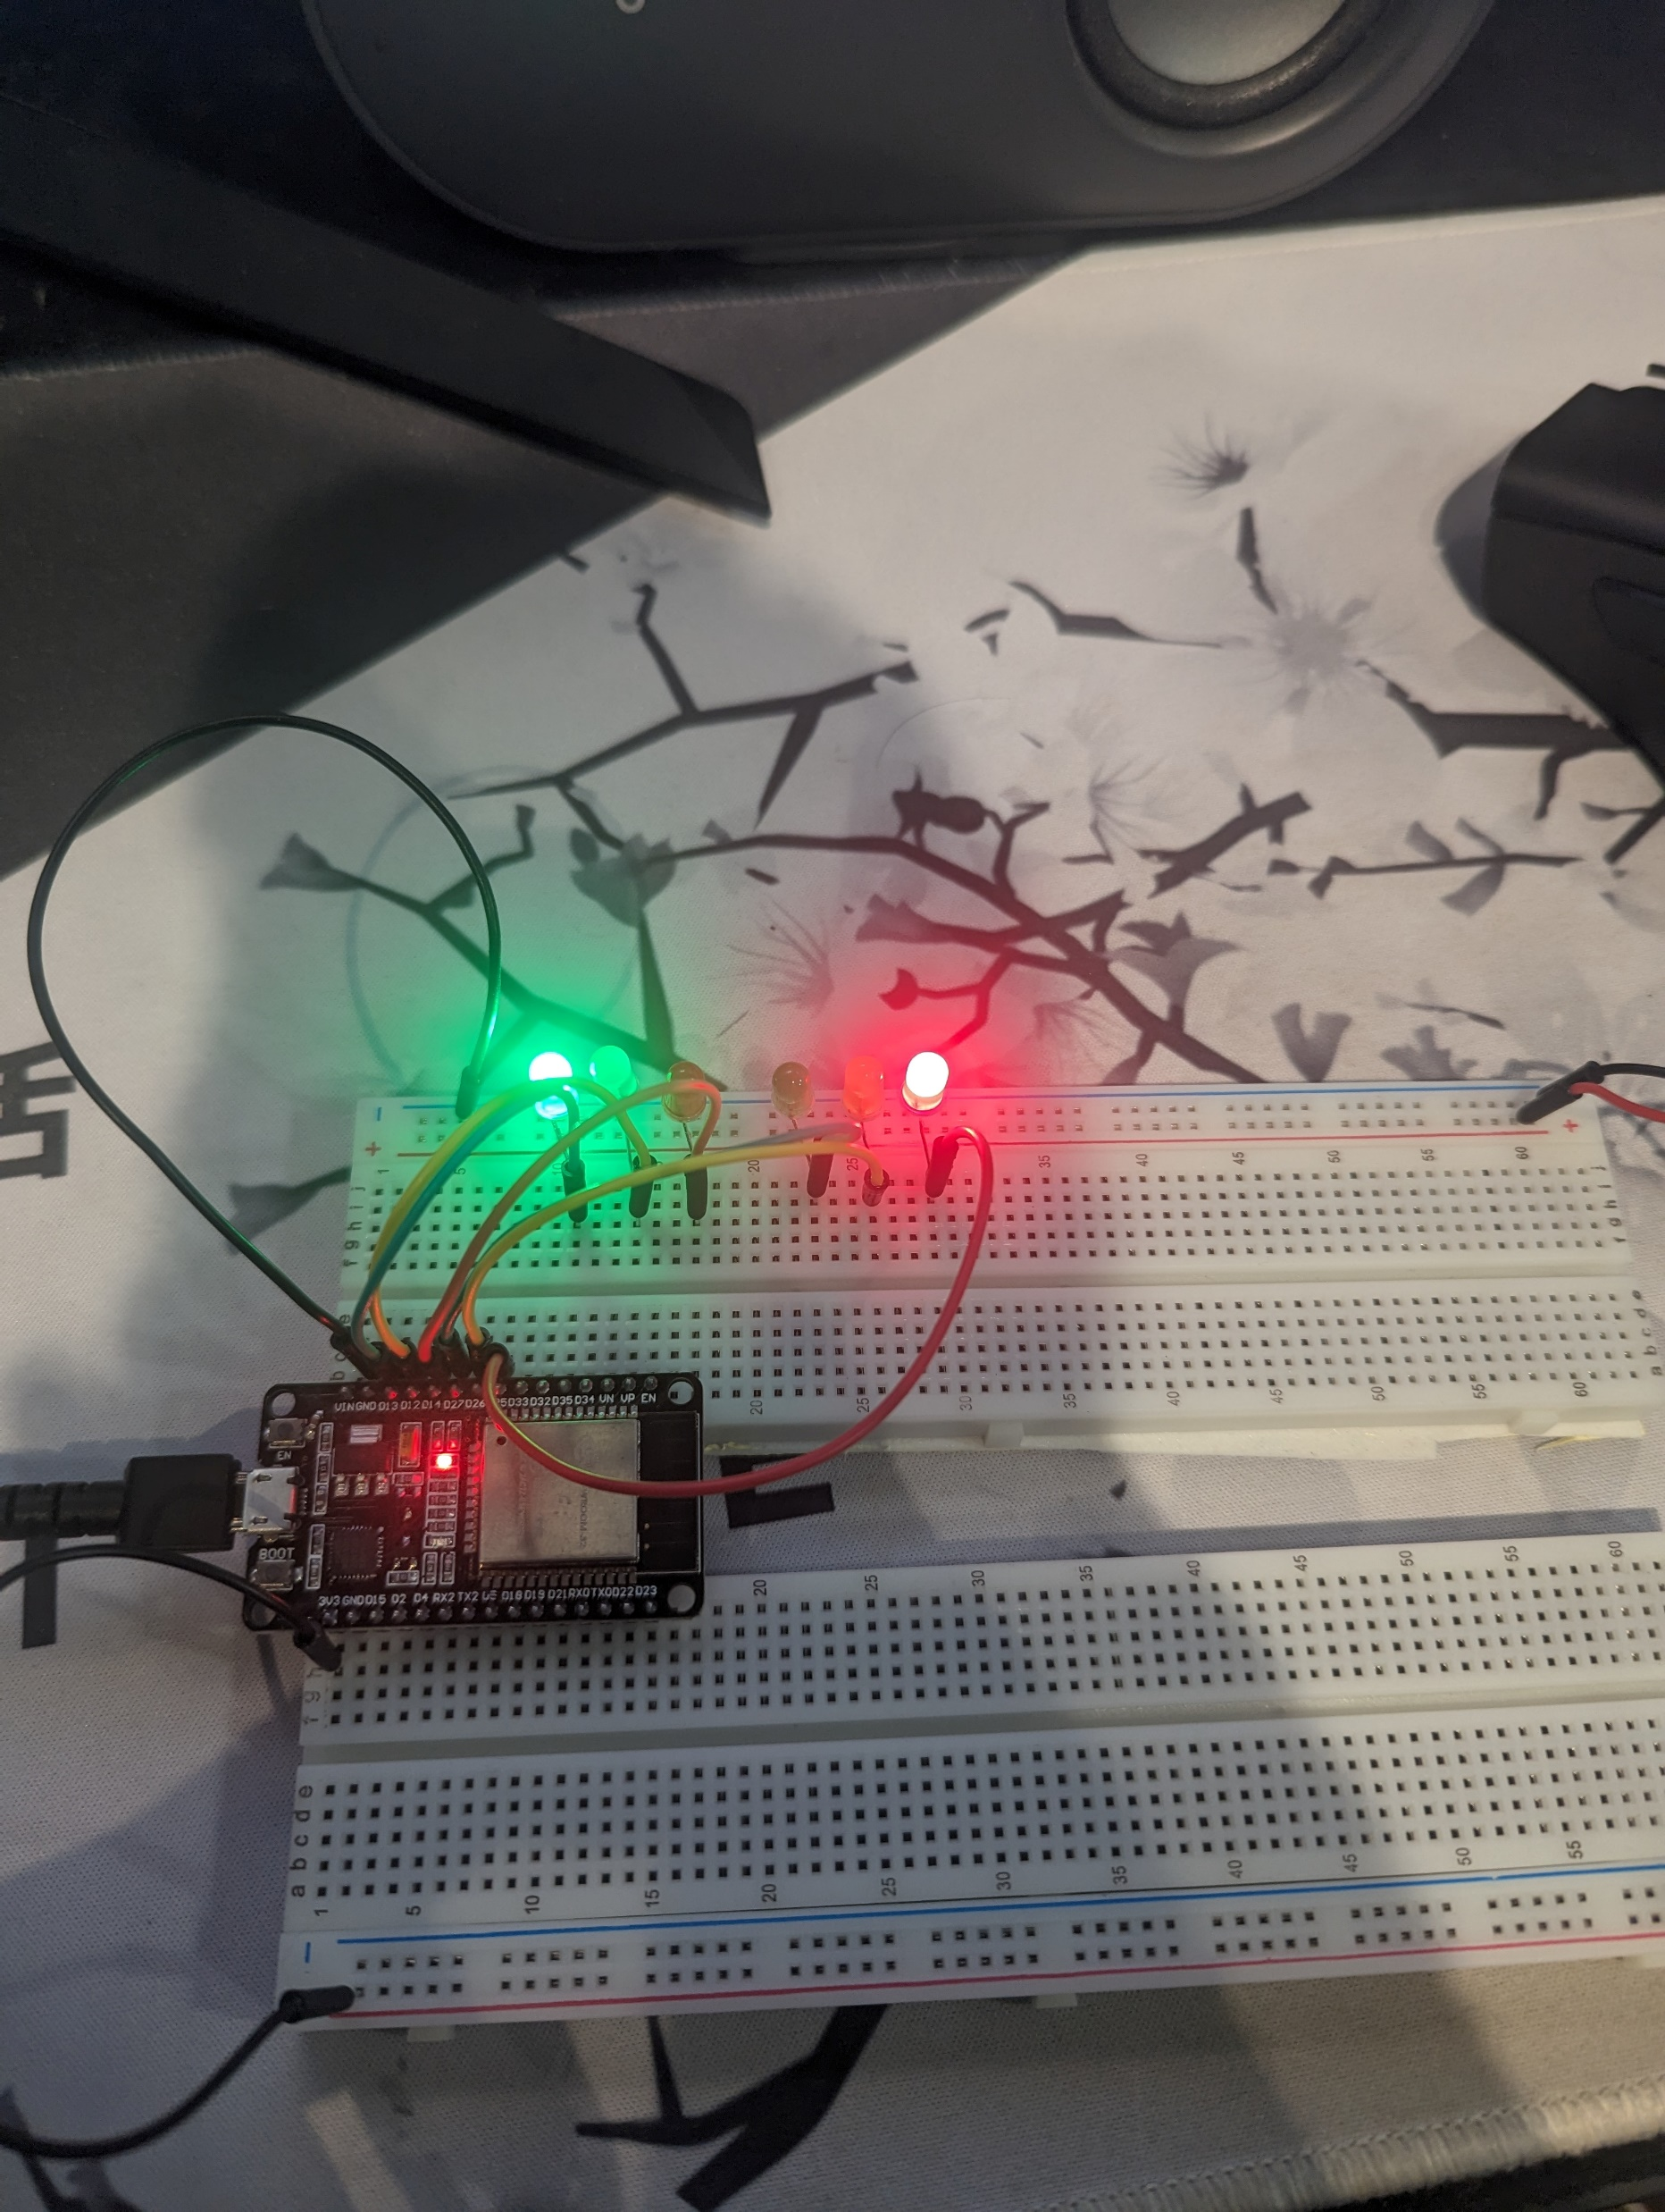
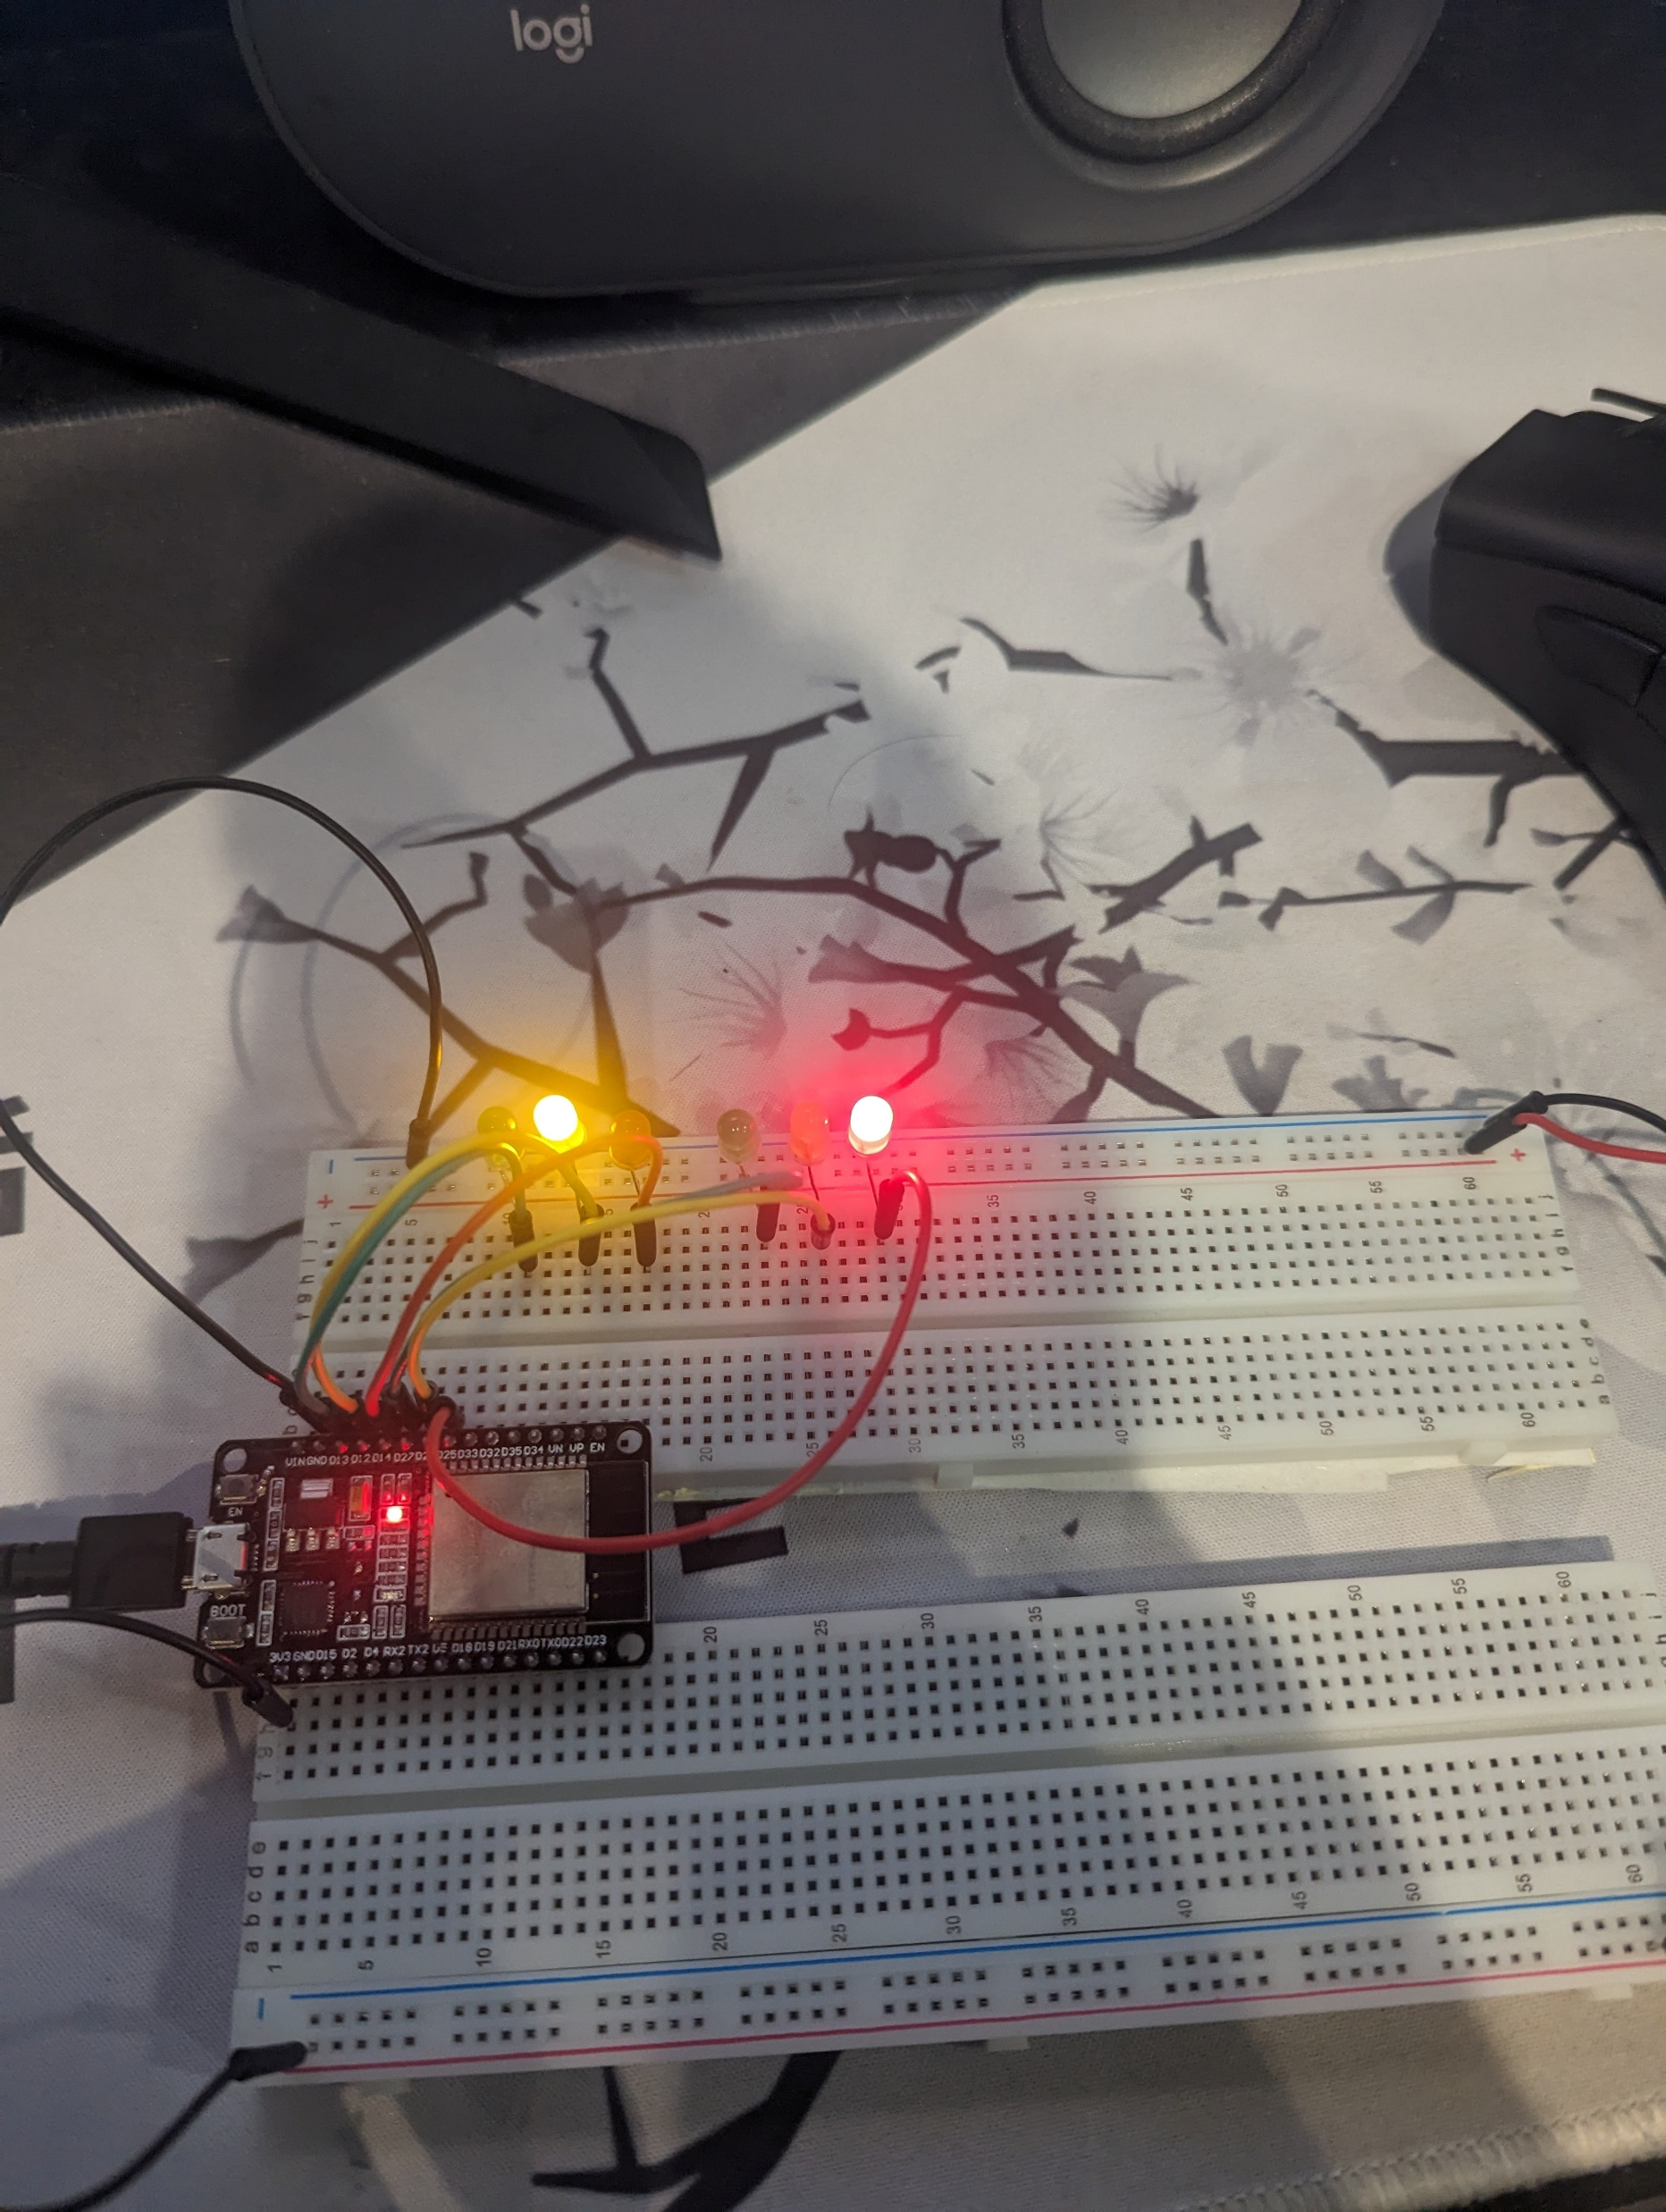
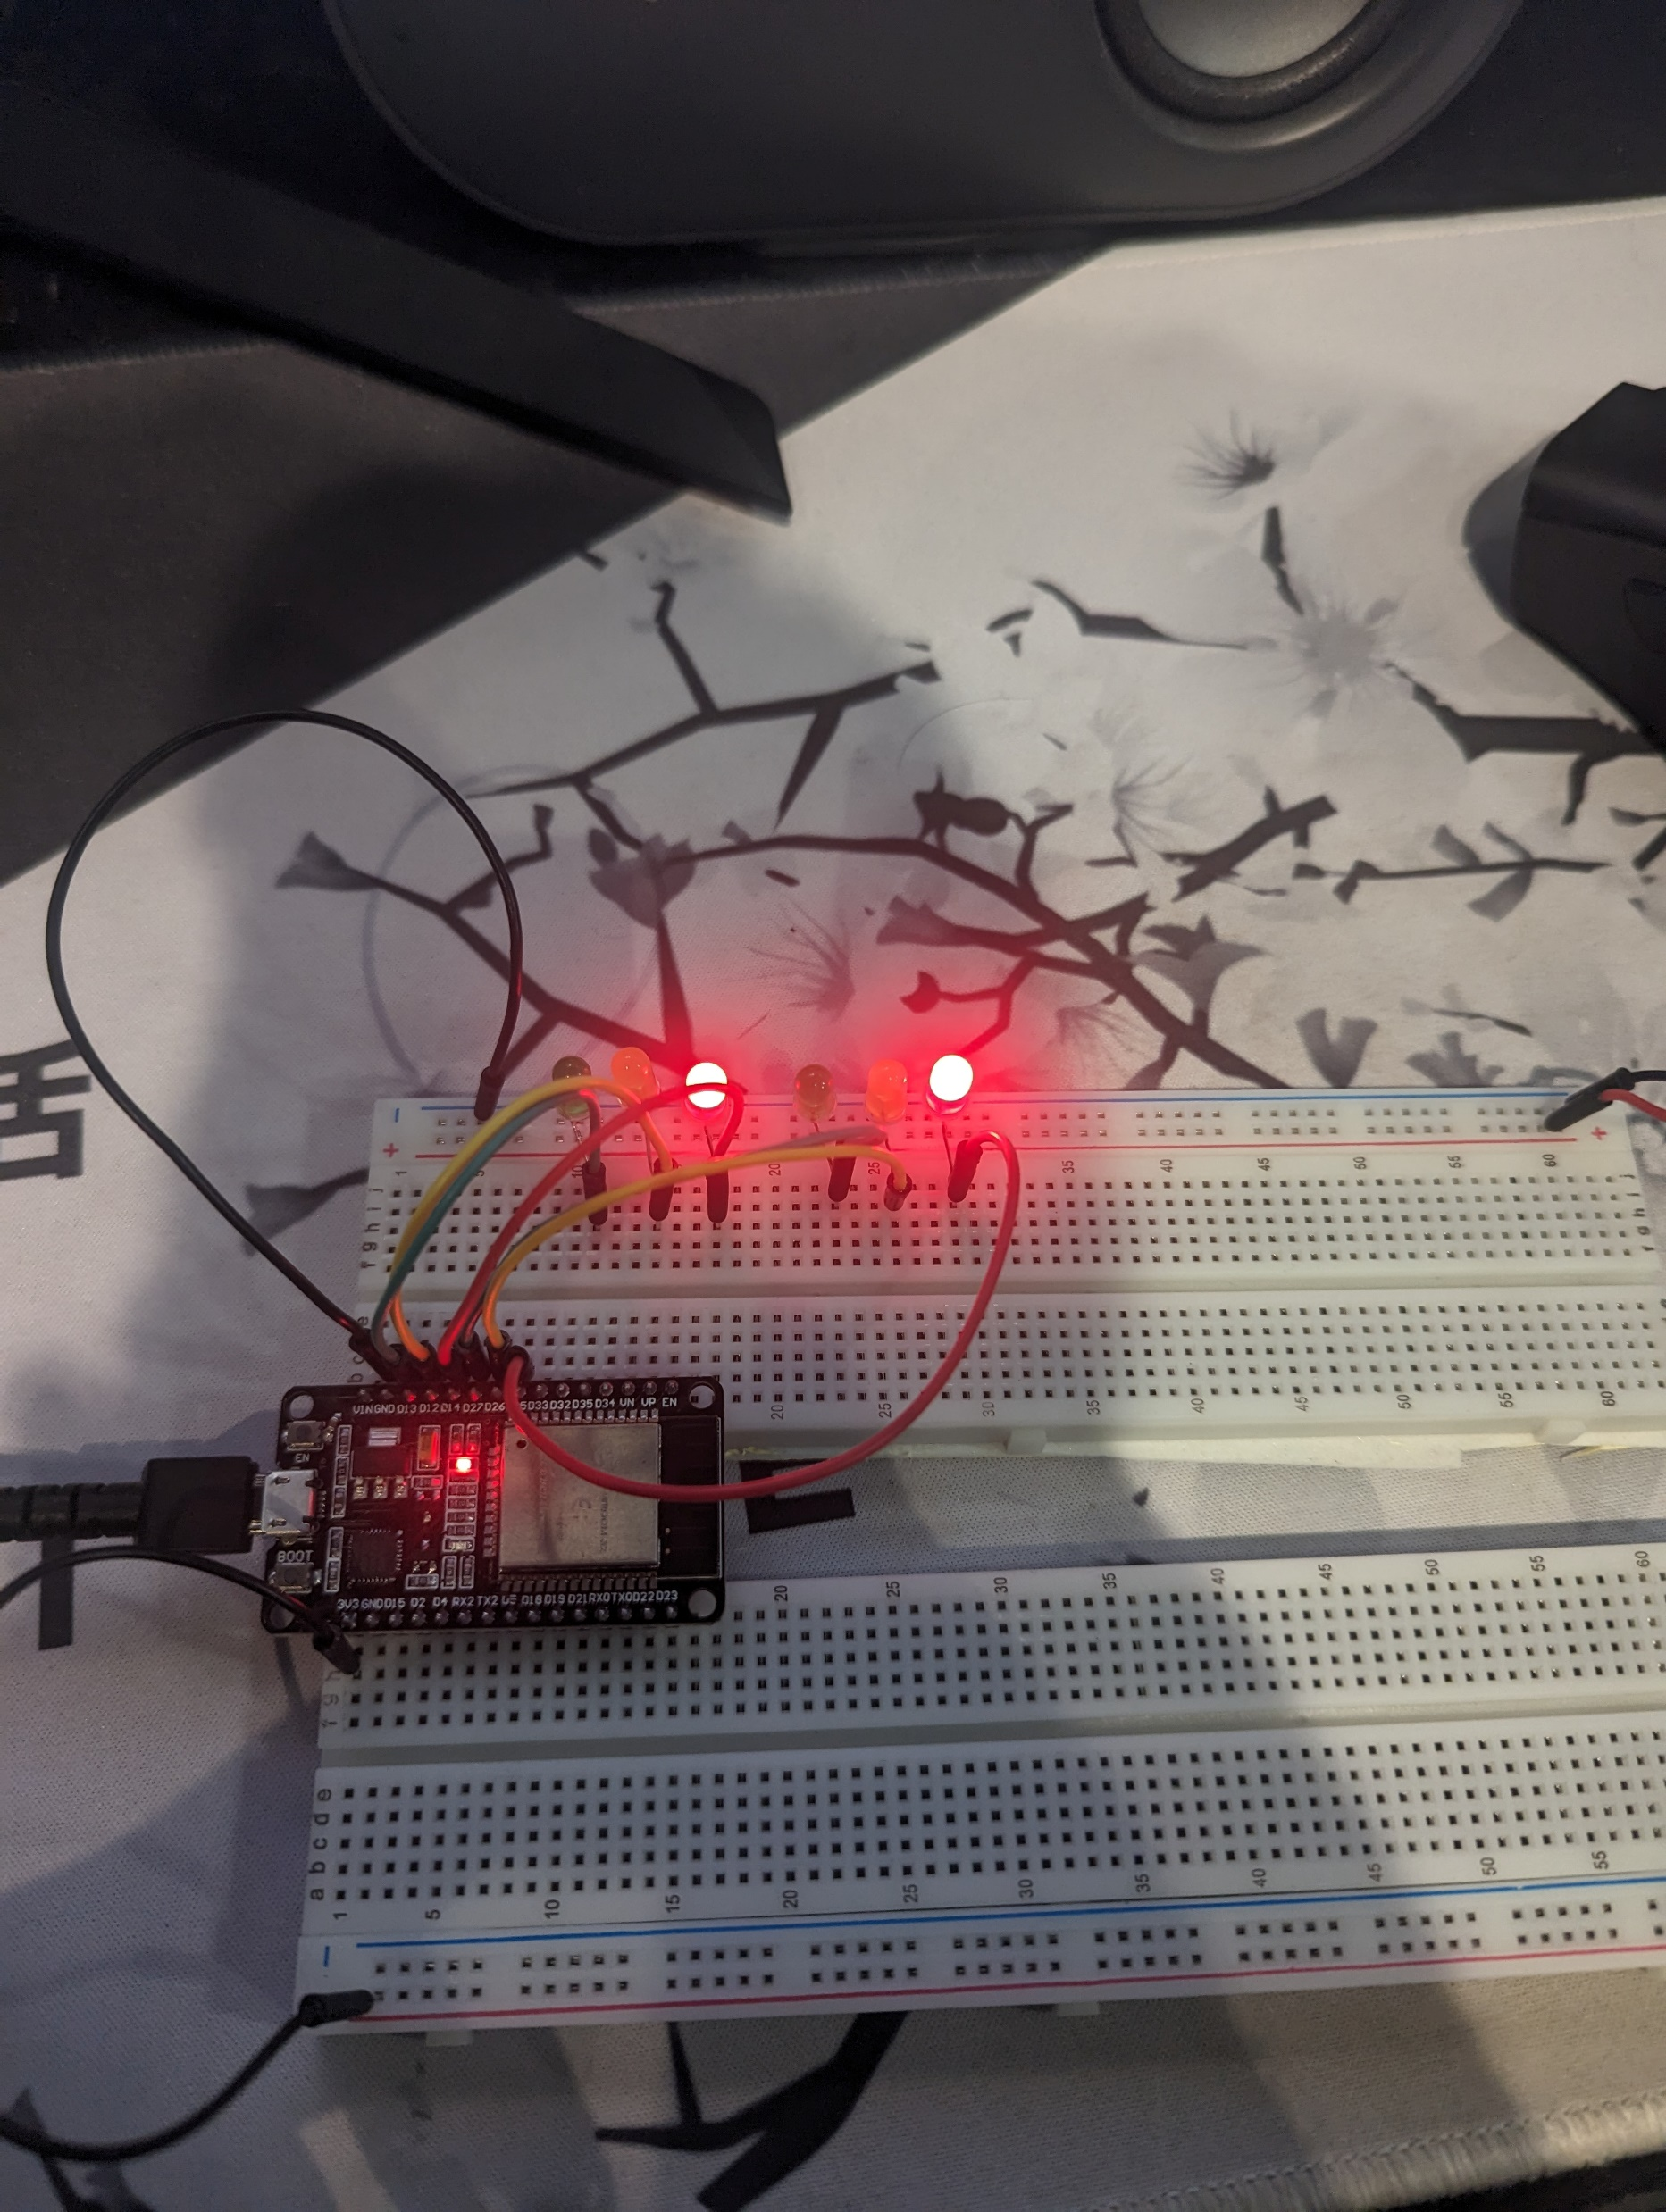
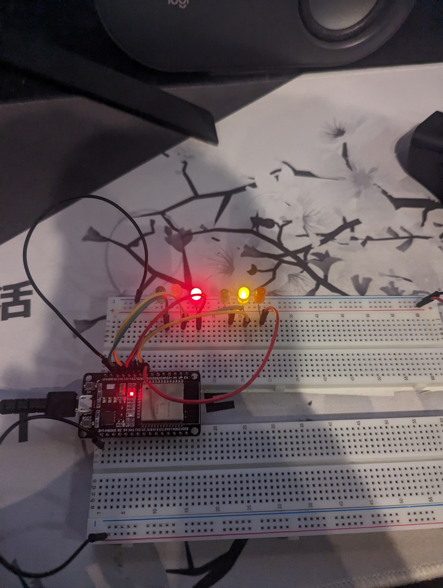
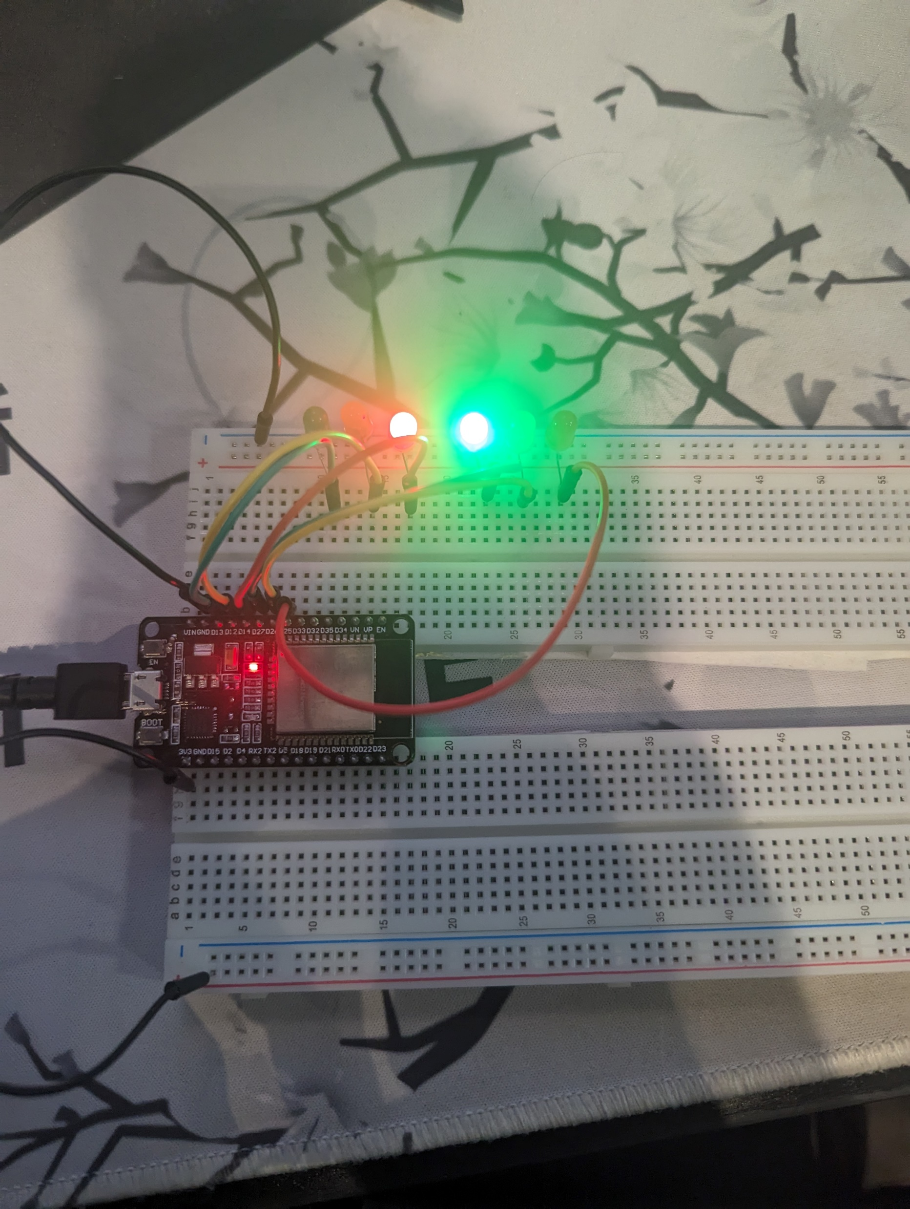
Picture of circuit with working LEDs
ESP 32 Board
Colored LEDs: Red, Yellow and Green (two sets)
220 Ohm Resistors (optional)
Wires
Breadboard

Slide 13
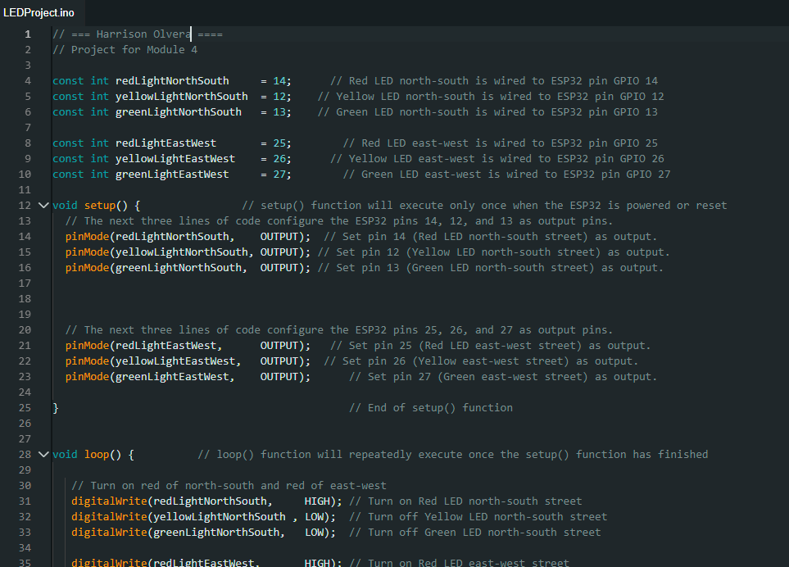
Screenshot of code in Arduino IDE
Screenshot of code in Arduino IDE showing your name in the comment

Slide 14
Creating a Multiple Traffic Light Controller with a Cross Walk

Slide 15
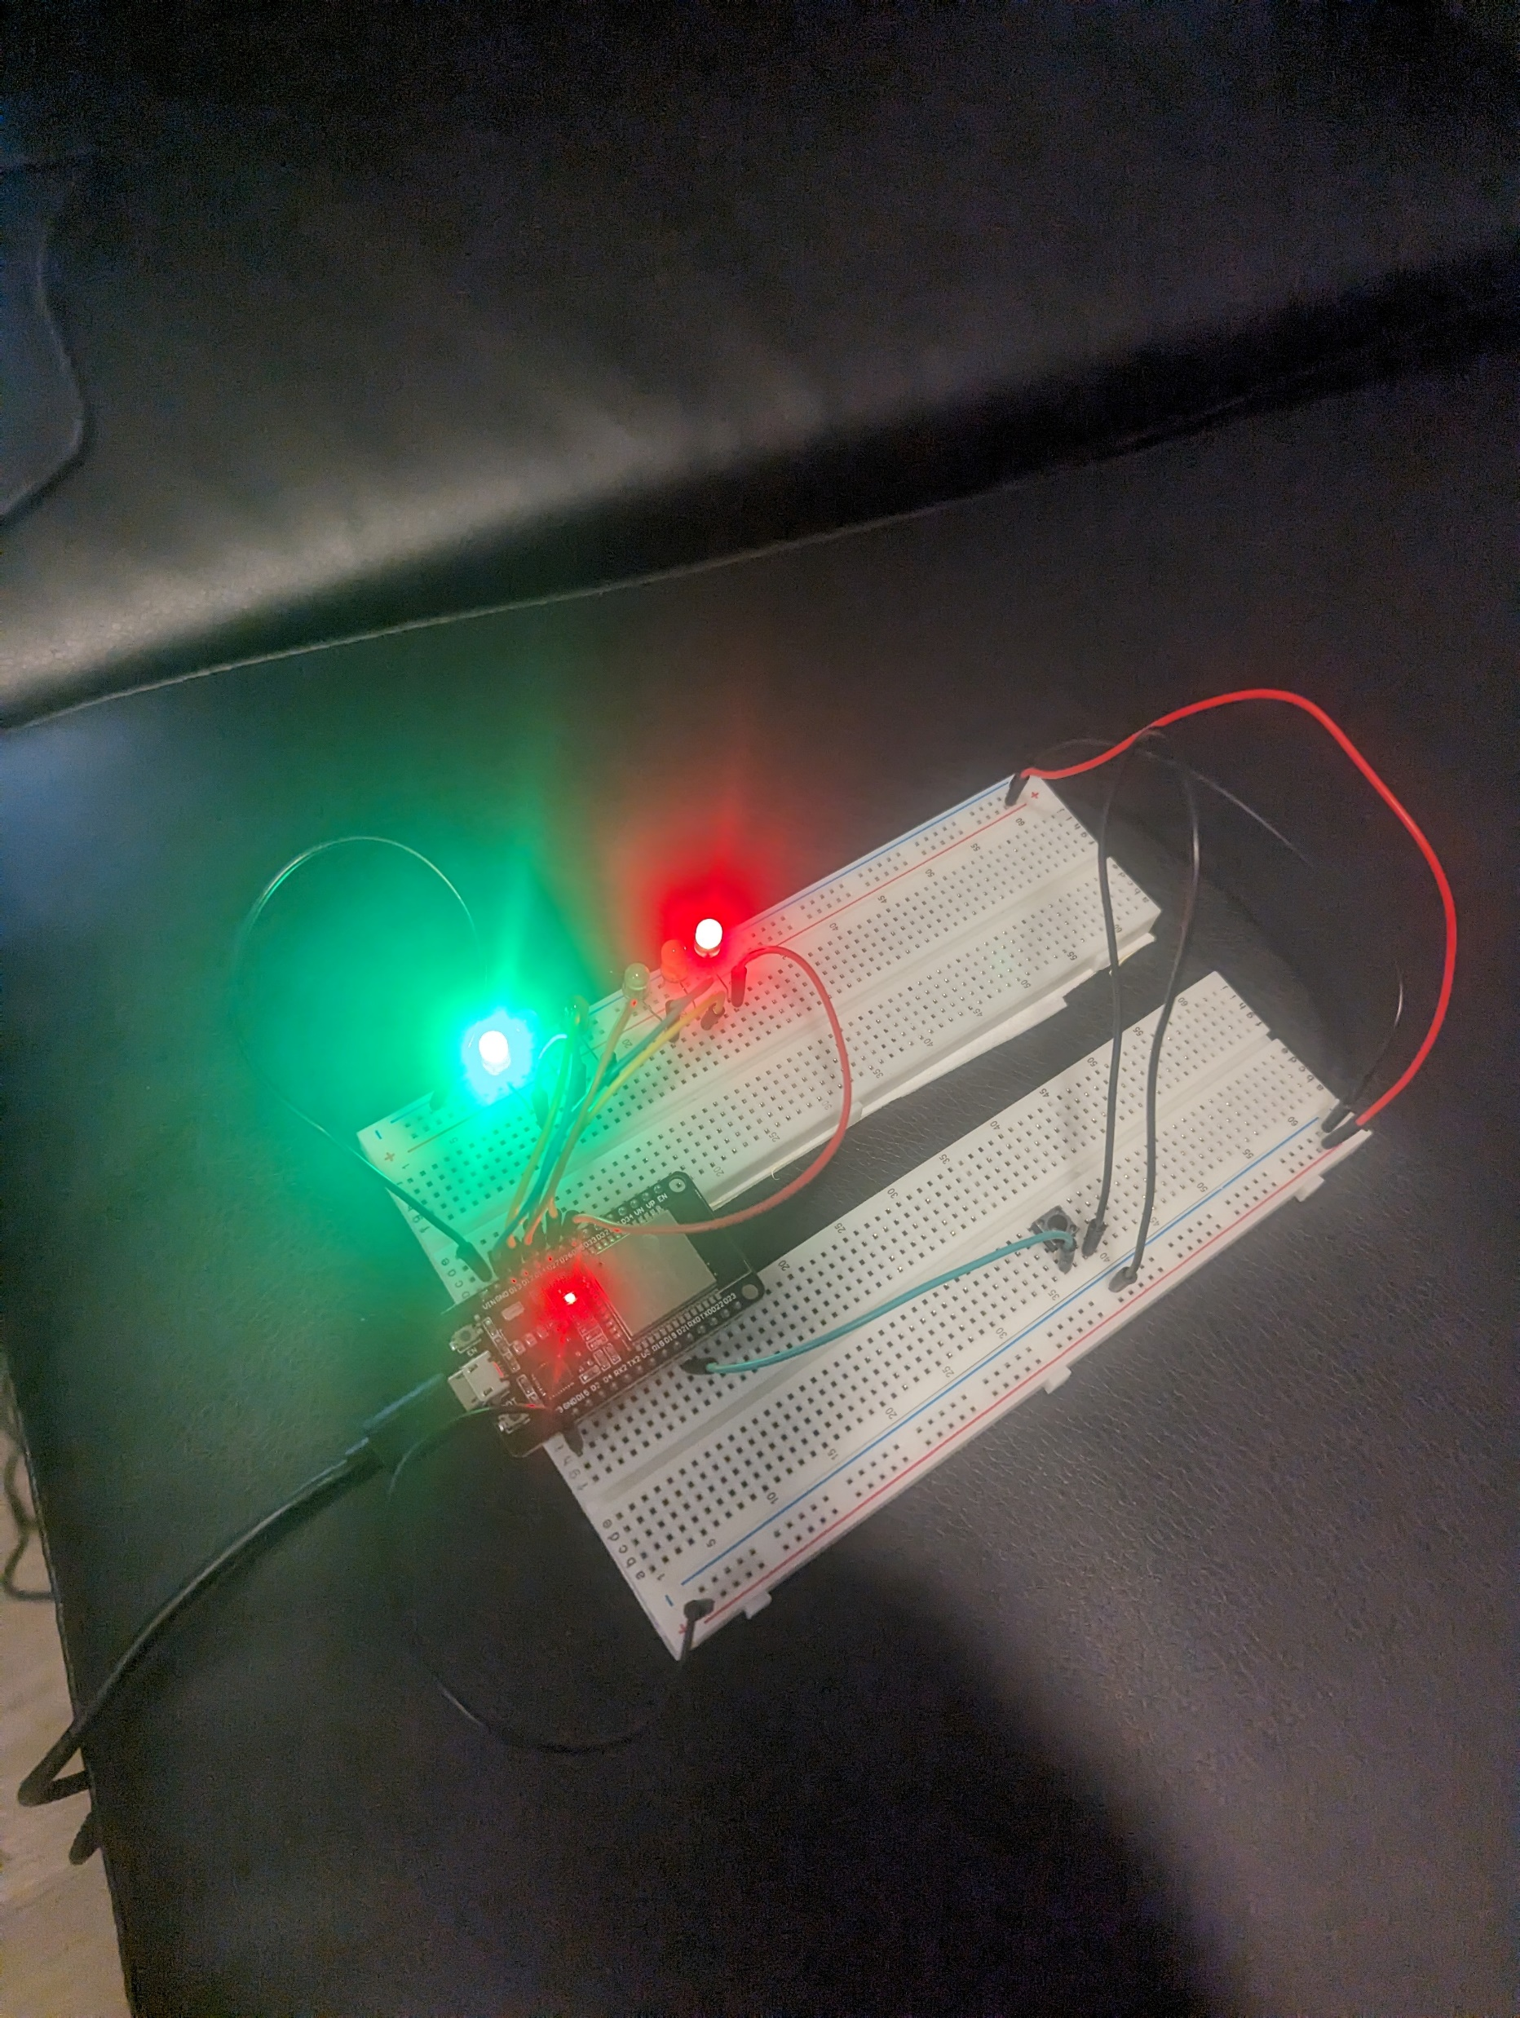
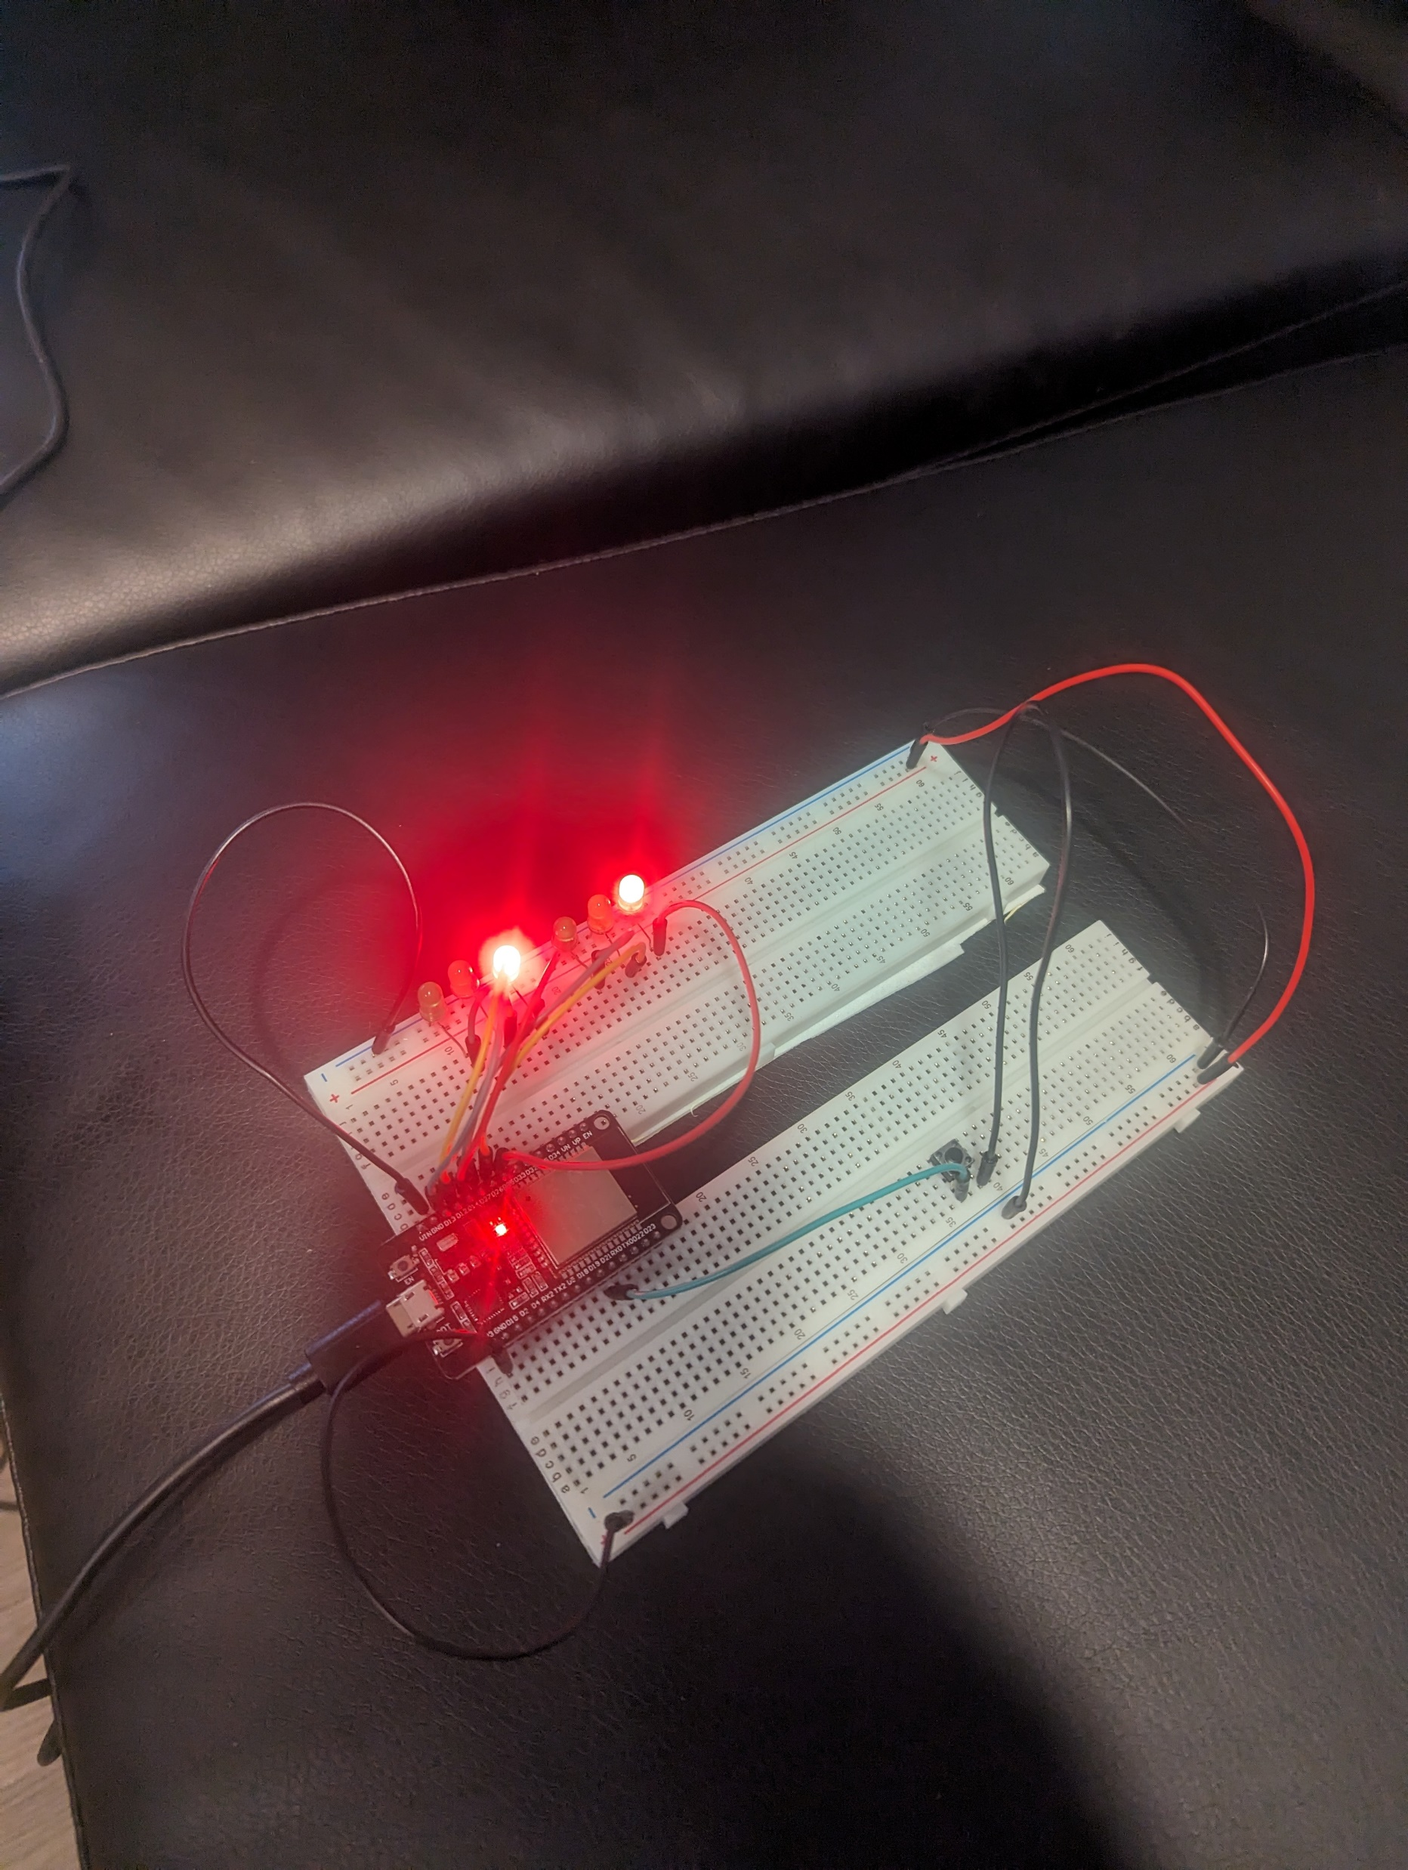
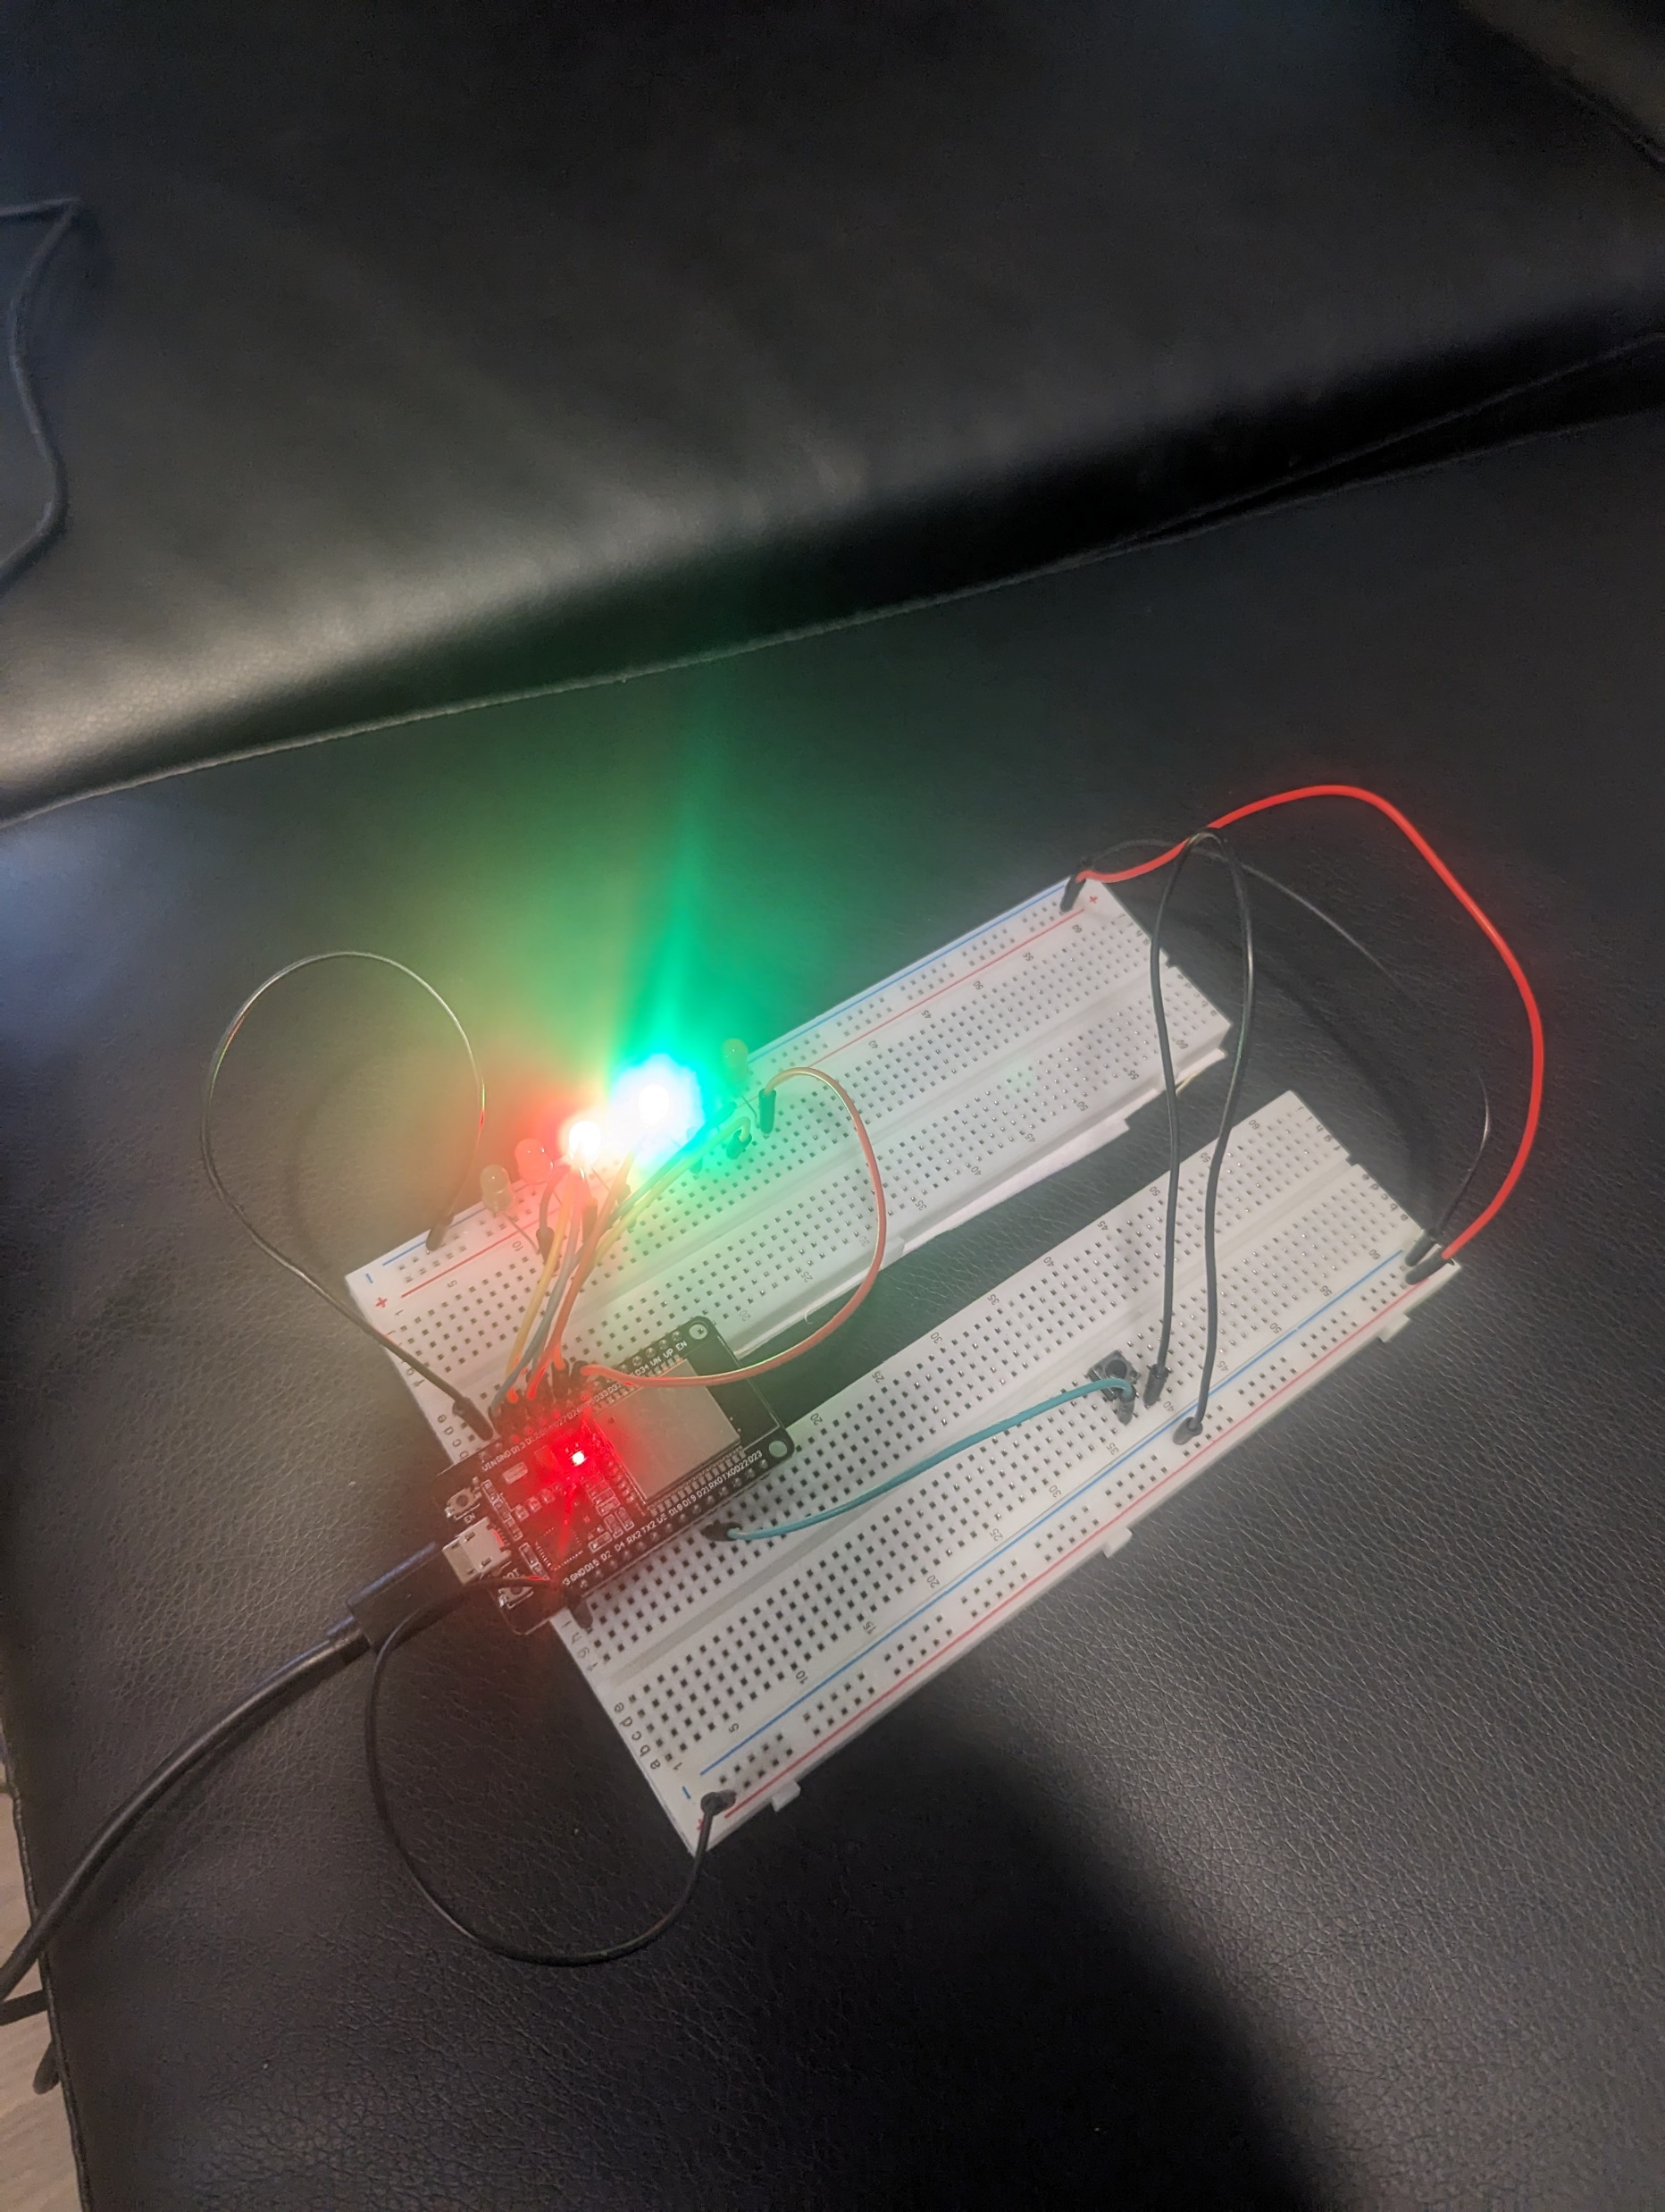
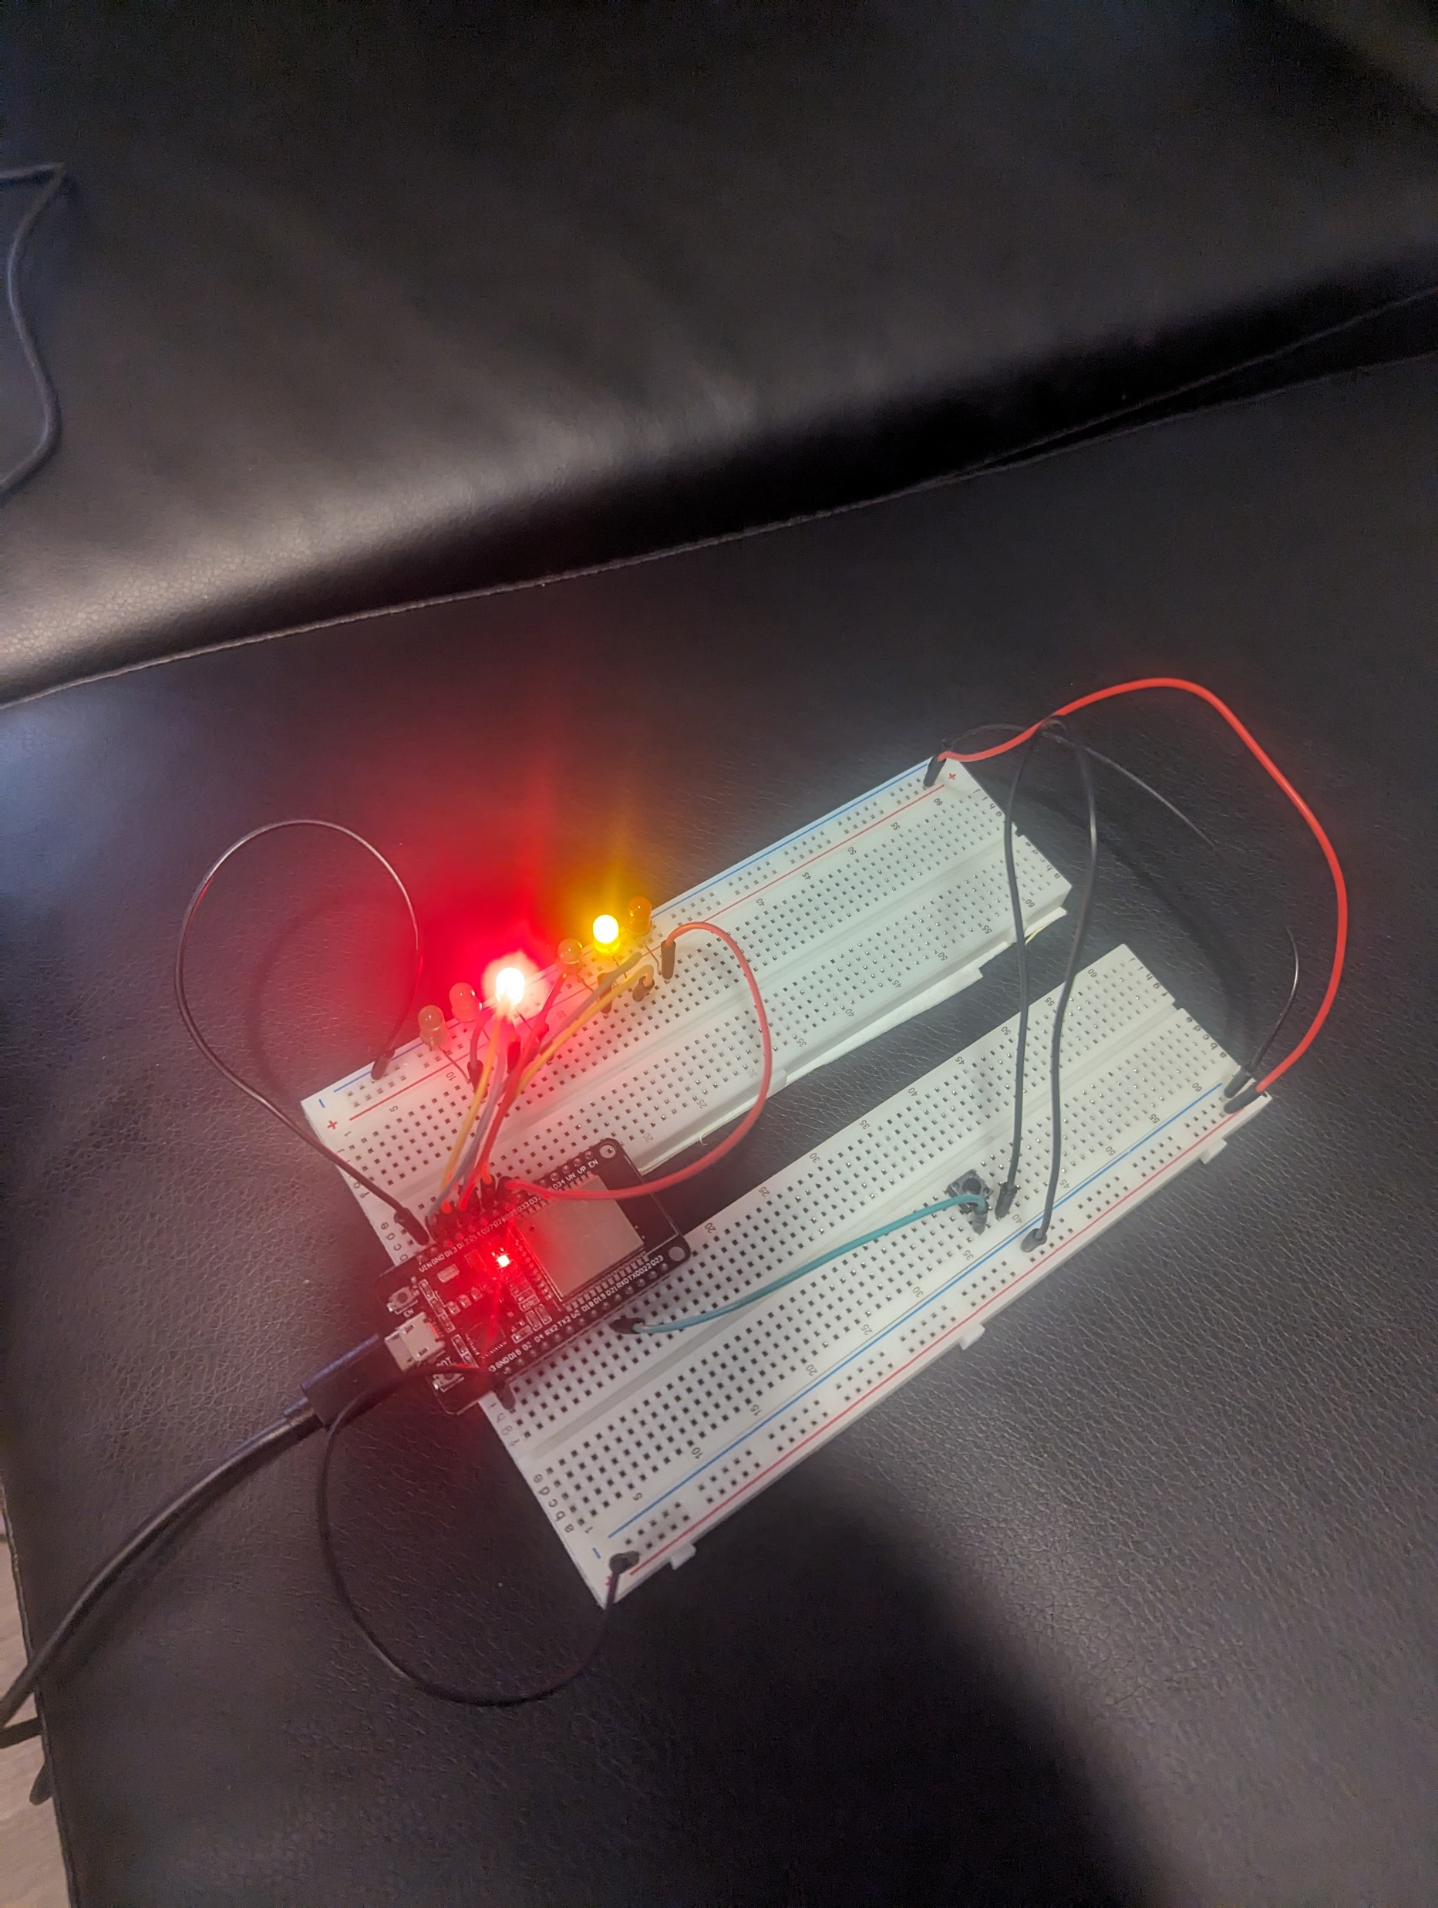
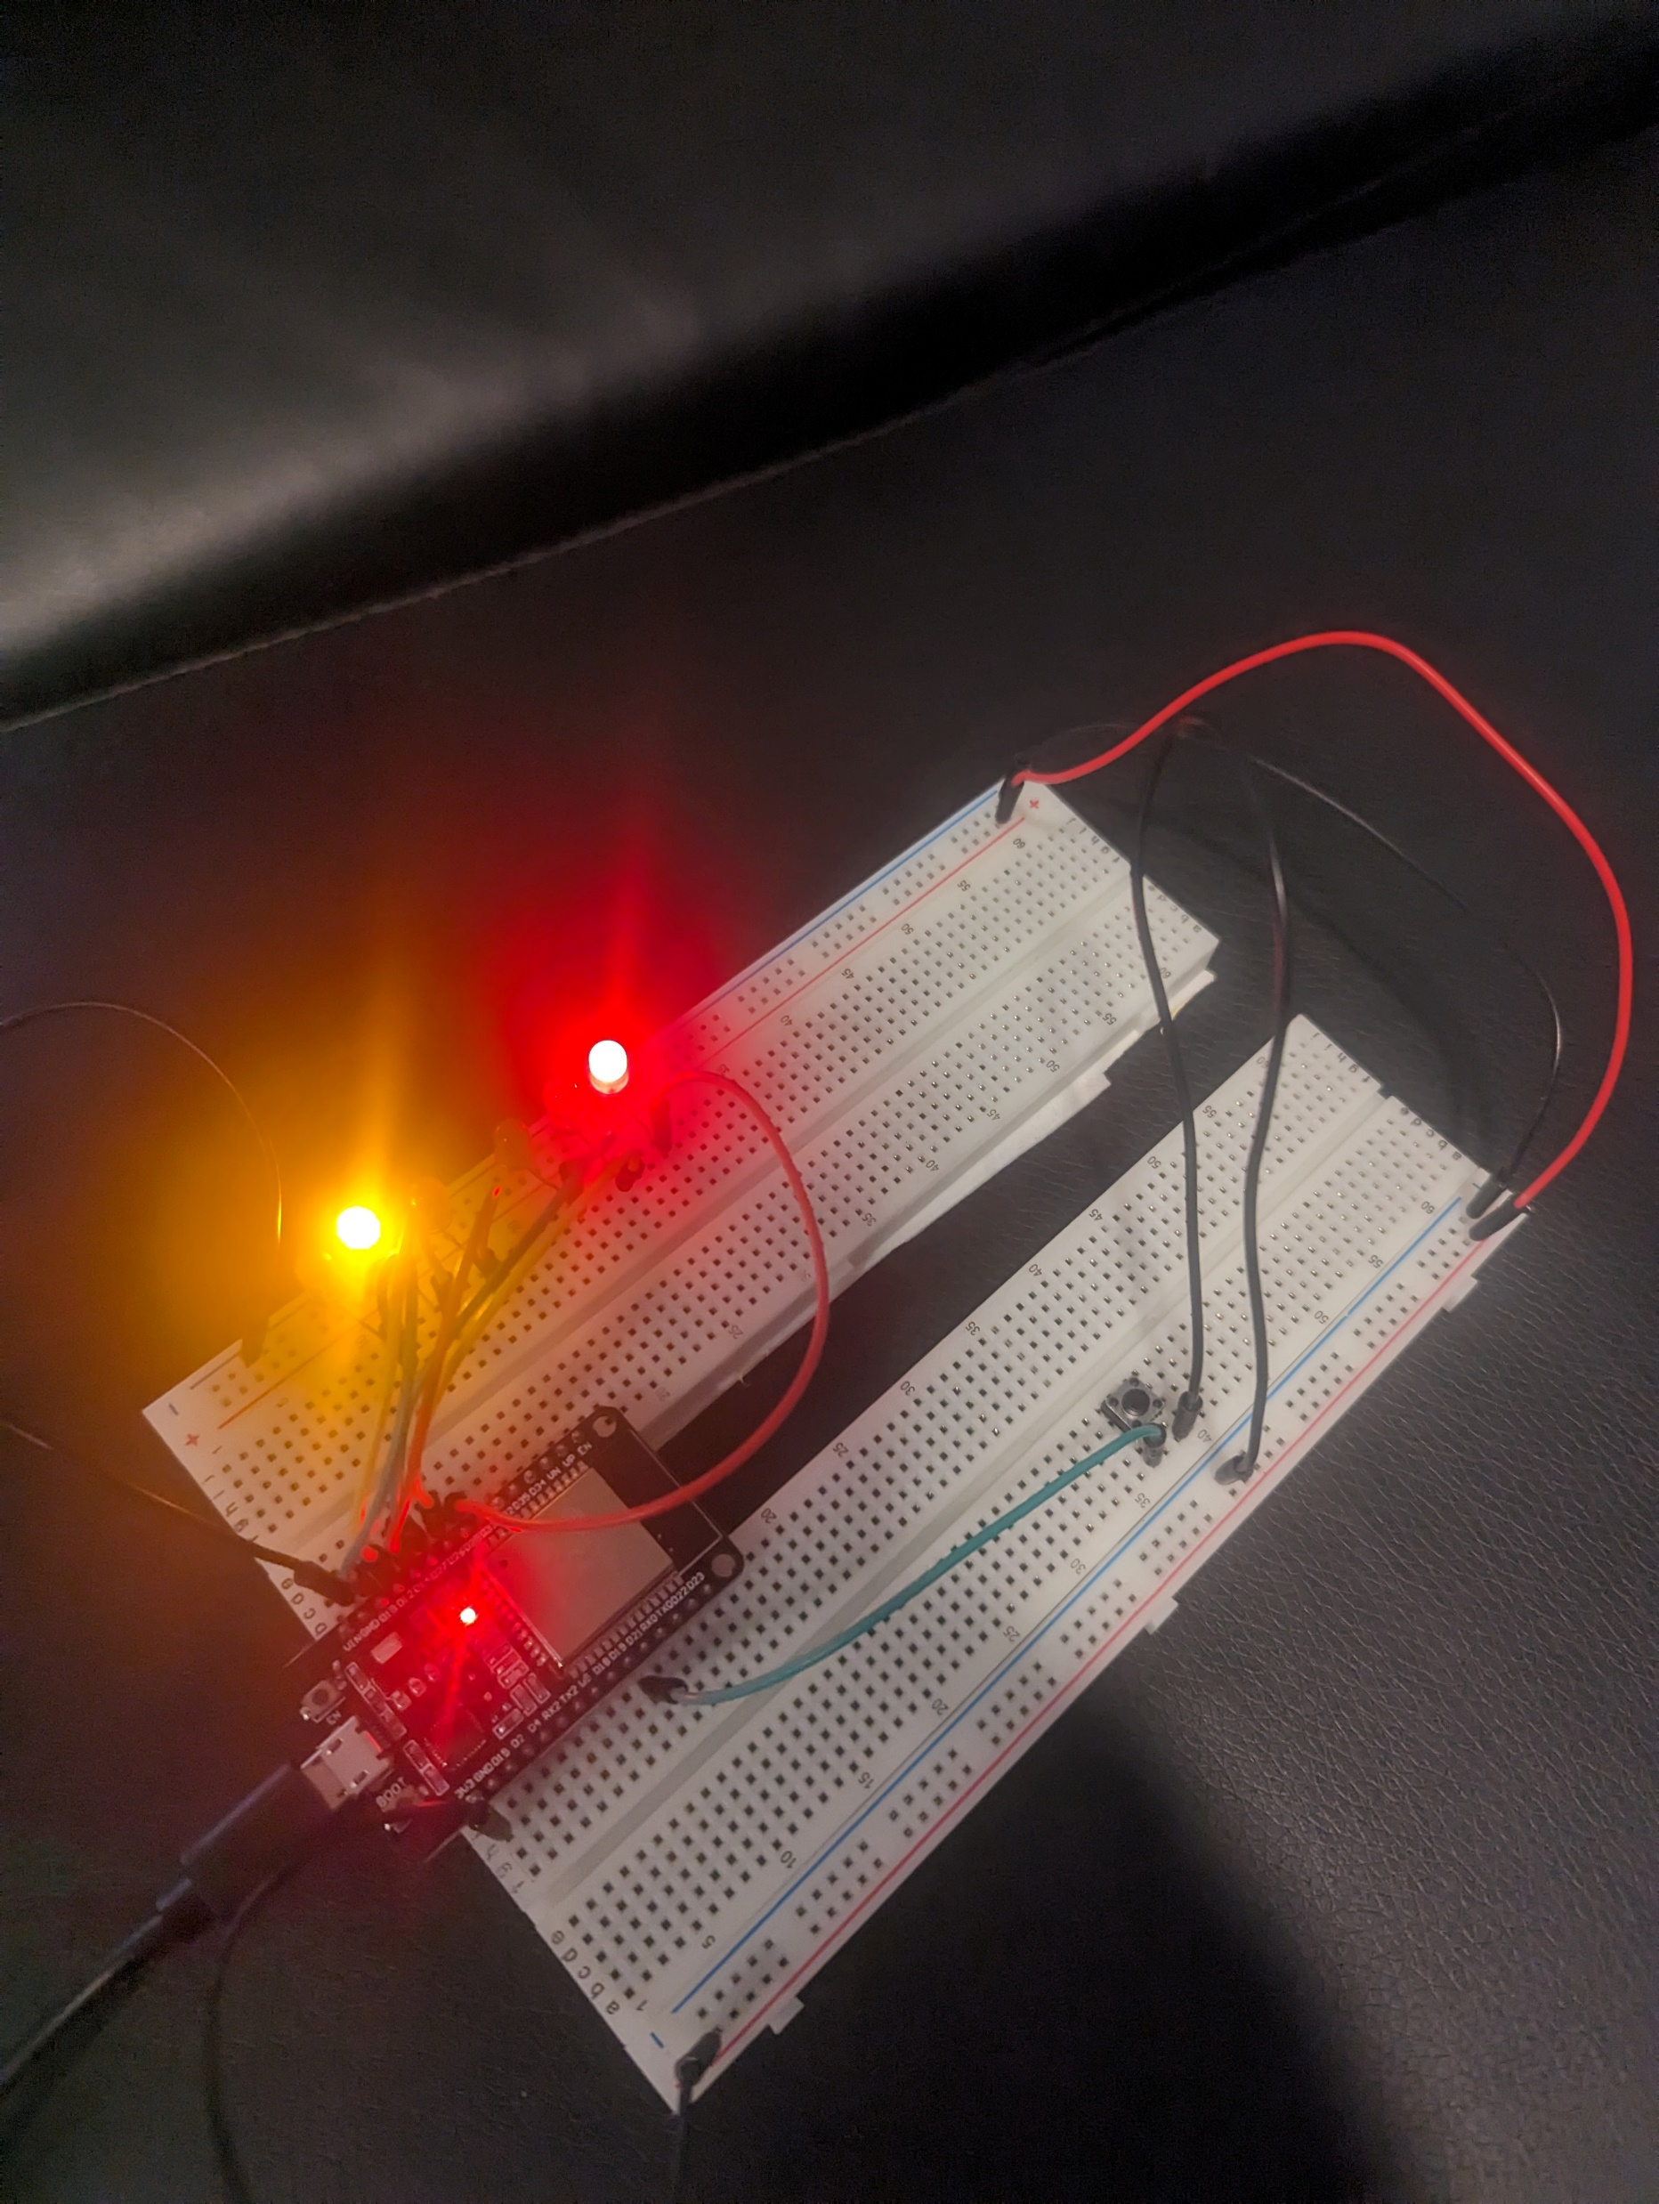
Picture of circuit with working LEDs
ESP 32 Board
Colored LEDs: Red, Yellow and Green (two sets)
220 Ohm Resistors (optional)
Push Button
Wires
Breadboard

Slide 16
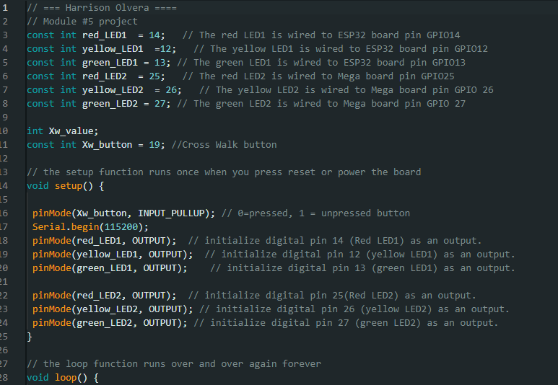
Screenshot of code in Arduino IDE
Screenshot of code in Arduino IDE showing your name in the comment

Slide 17
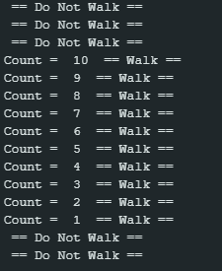
Screenshot of Serial Monitor in Arduino IDE
Screenshot of output in Serial Monitor

Slide 18
Creating a Multiple Traffic Light Controller with a Cross Walk and an Emergency Buzzer

Slide 19
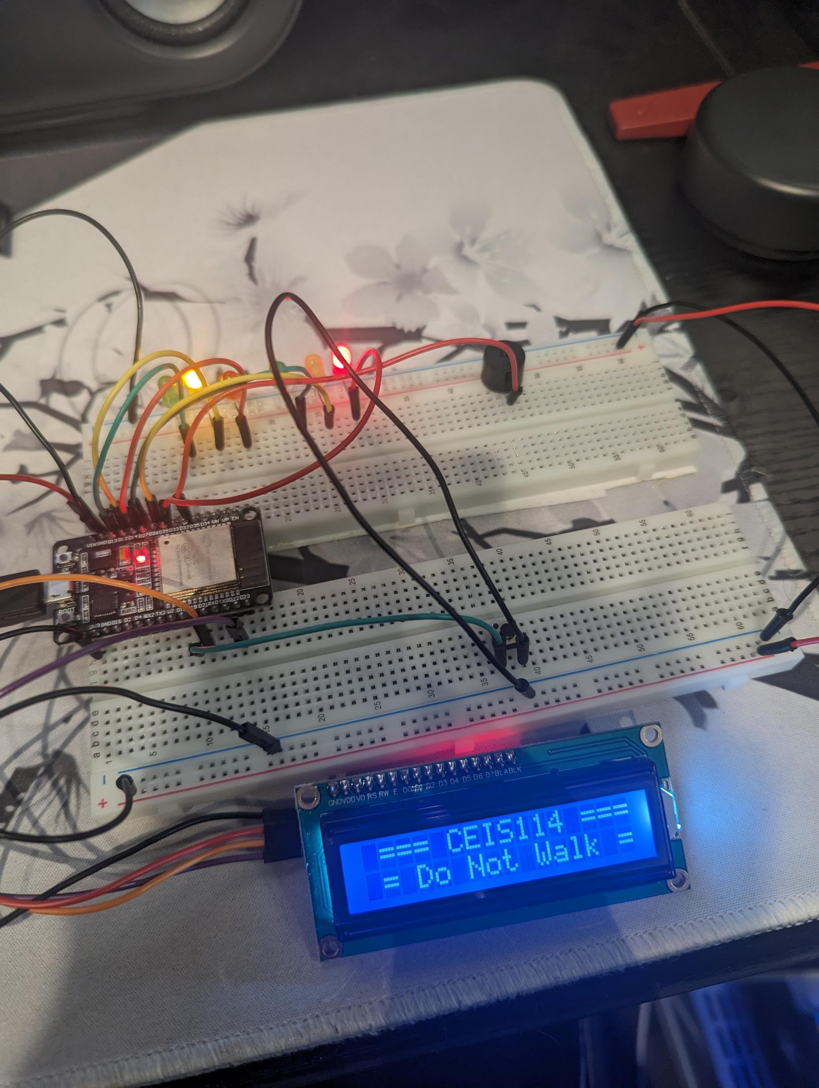
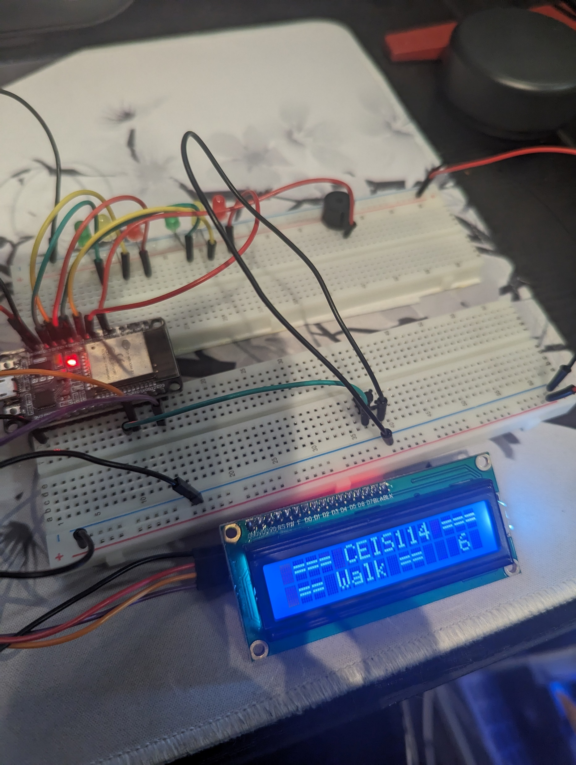
Picture of circuit with working LEDs and LCD display
ESP 32 Board
Colored LEDs: Red, Yellow and Green (two sets)
220 Ohm Resistors (optional)
Push Button
LCD Unit with Message Display
Wires
Breadboard

Slide 20
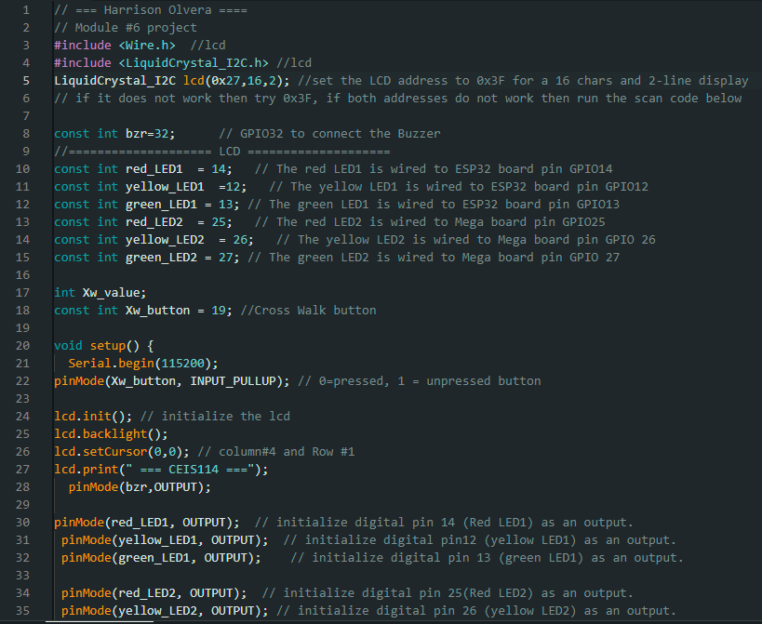
Screenshot of code in Arduino IDE
Screenshot of code in Arduino IDE showing your name in the comment

Slide 21
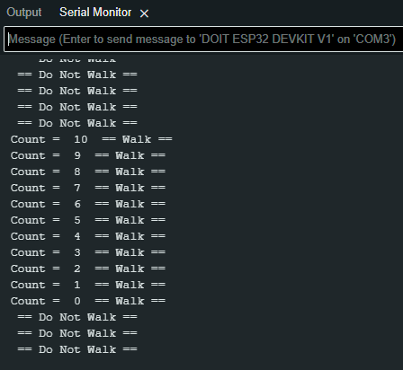
Screenshot of Serial Monitor in Arduino IDE
Screenshot of output in Serial Monitor

Slide 22
Creating a Multiple Traffic Light Controller with a Cross Walk and an Emergency Buzzer with SMART sensor

Slide 23
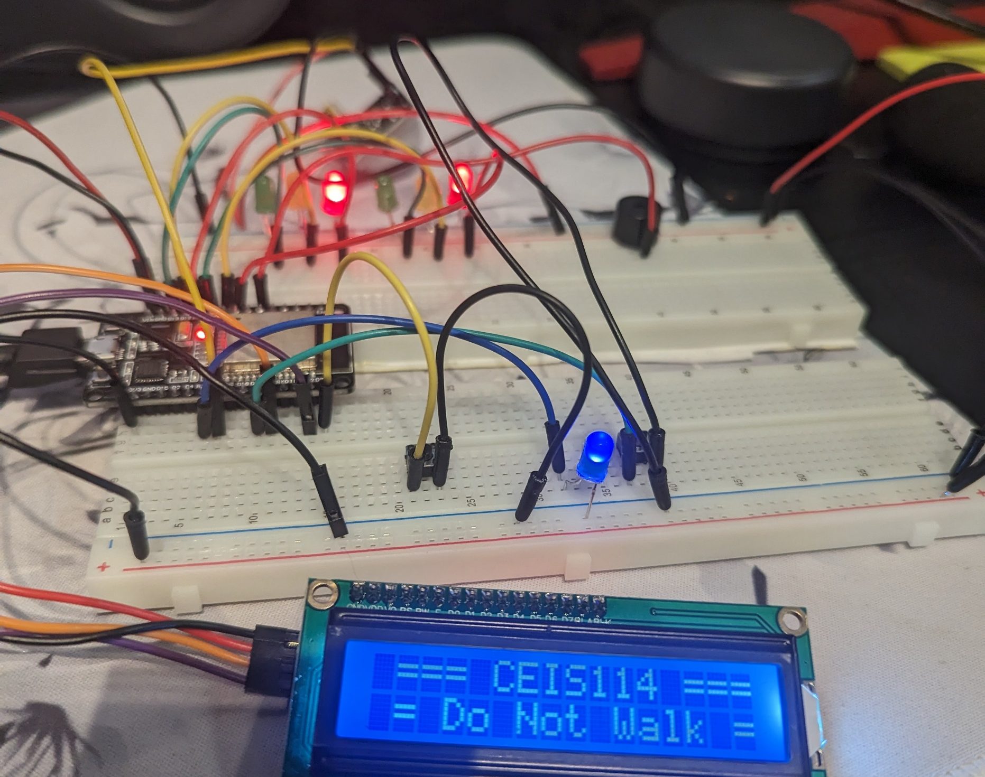
Screenshot of circuit with working LEDs and LCD display (Building/Operation)
ESP 32 Board
Colored LEDs: Red, Yellow and Green (two sets)
One Blue LED – Emergency Light
220 Ohm Resistors (optional)
Push Button
LCD Unit
Buzzer
Wires
Breadboard

Slide 24
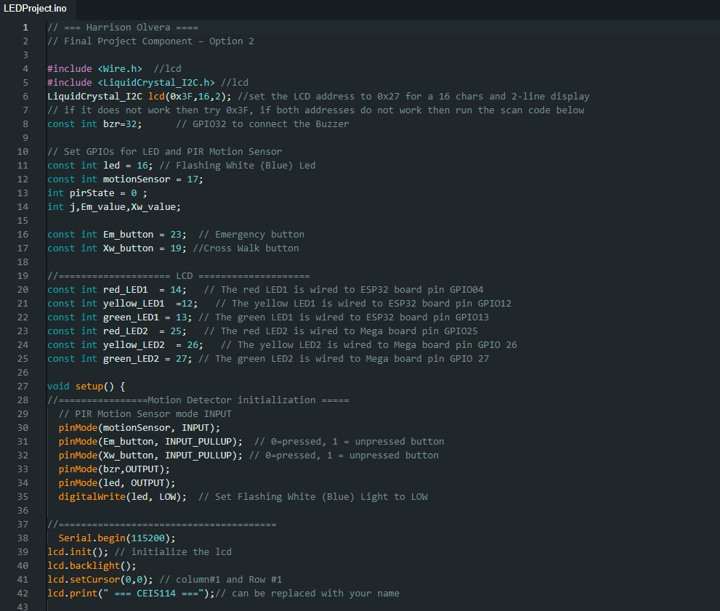
Screenshot of code in Arduino IDE (Testing)
Screenshot of code in Arduino IDE showing your name in the comment

Slide 25
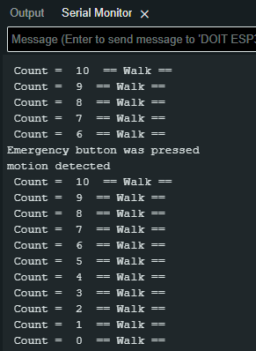
Screenshot of Serial Monitor in Arduino IDE (Testing)
Screenshot of output in Serial Monitor

Slide 26
Challenges/lessons learned
What challenges did you face while working on the project?
I struggled with the device not working as intended. Many of these issues involved lights not turning on, the LCD screen not displaying the correct message, and the active speaker not turning on.
How did you overcome these challenges?
I looked carefully back at the example shown in the guide. Sometimes all it took was disconnecting some of the wires and connecting them back.
What lessons did you learn?
How to create an IoT system utilizing principles of technology.
How to communicate with a team and obtain different points of view on a project.
How to operate a smart traffic light controller.

Slide 27
Career skills
Embedded Systems Programming
IoT Development
Sensor Integration
Real-time Systems
UI Development
Problem Solving
Error Troubleshooting

Slide 28
Peer review
During the final project, our class was split up into groups. In the groups, we would discuss our plans on how we would develop our project, which option we chose for the project, and why we chose that option. With this discussion, I was able to learn more about which option could be considered more beneficial and how each one can relate closely to a real traffic light.

Slide 29
Conclusion
With this project, I have gained a strong understanding of the skills and knowledge needed to create a smart traffic controller. Having the opportunity to gain on hands experience creating an IoT device is truly a blessing. Learning the principles of technology has helped me gain the confidence I need to continue projects like these in the future.

Slide 30
References
Devry University project videos and classes

